Slide 1
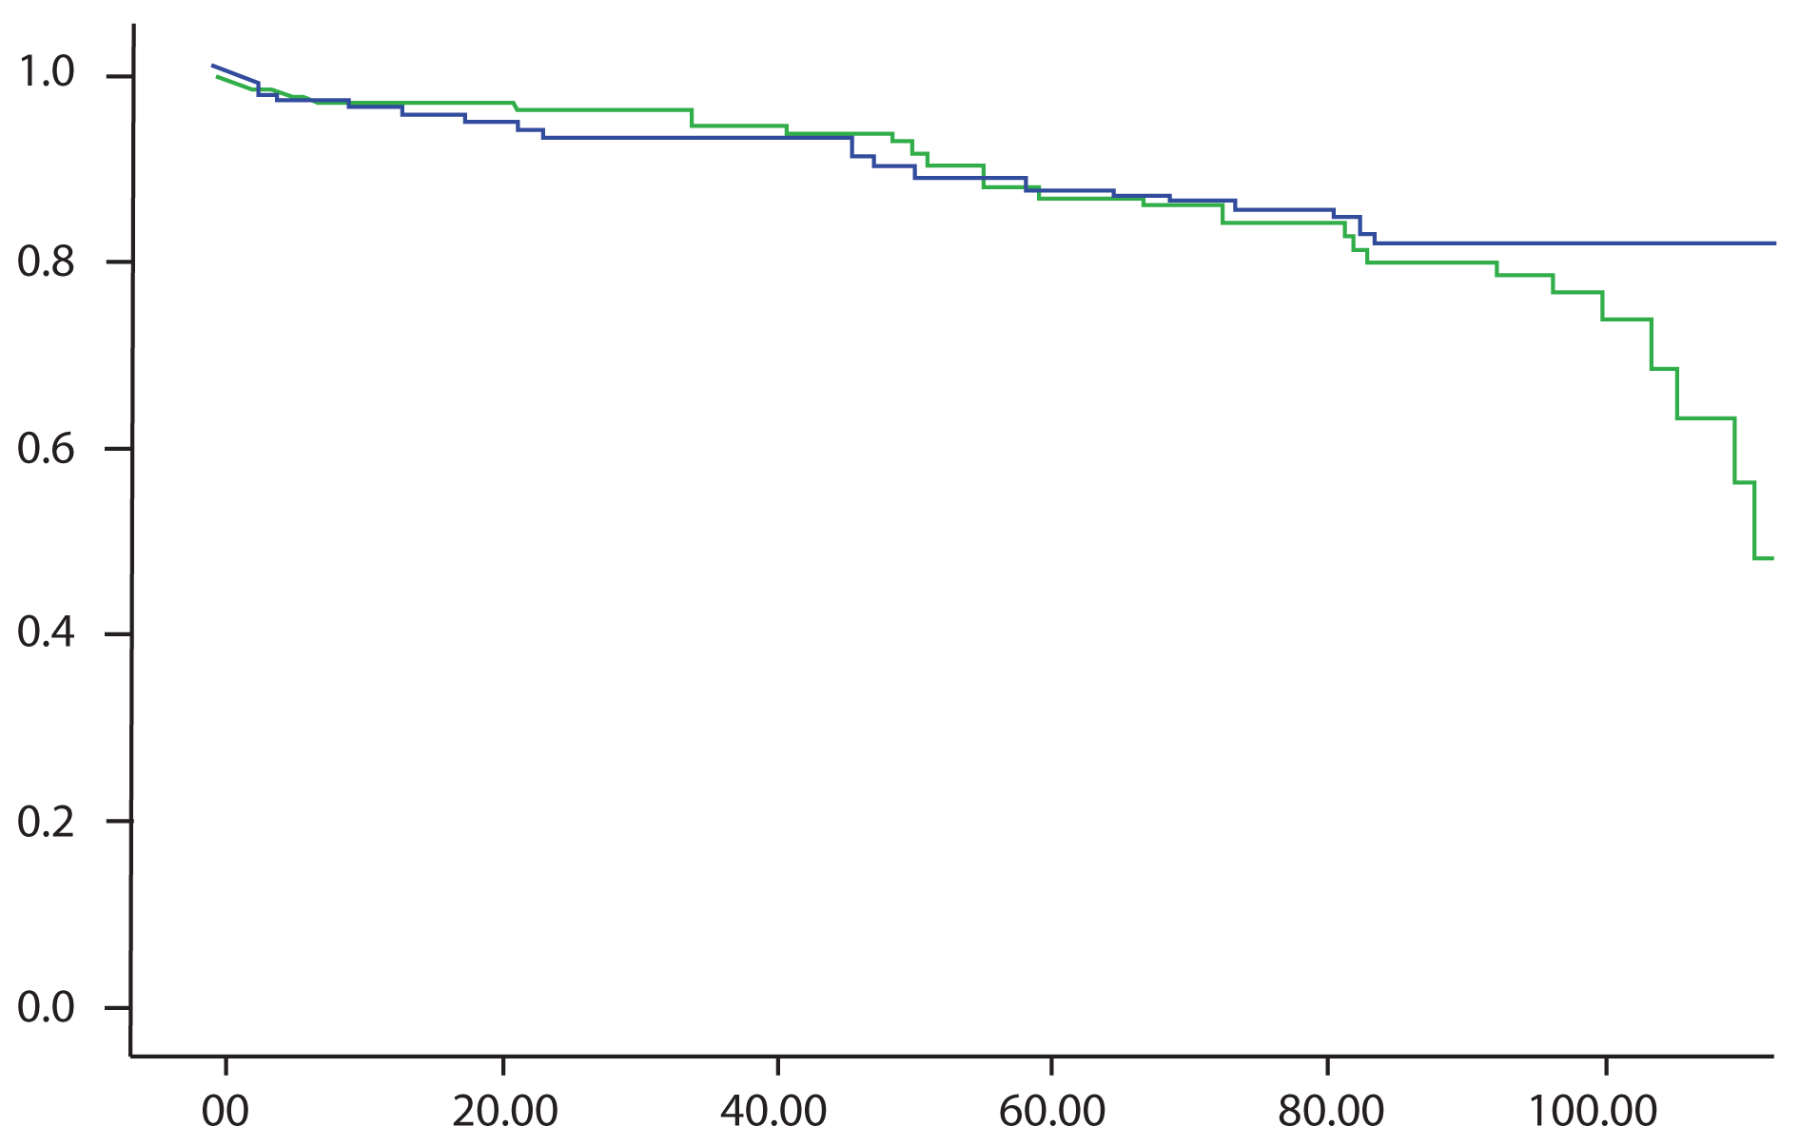
Figure 1.
Mean f/u duration : 45. 6 months
Cumulative survival
BITA group
Log rank test
BITA VS | 88.2 ± 0.02% | p=0.755
Single LITA | 87.1 ± 0.03 %
Single LITA group
Survival time (months)

Slide 2
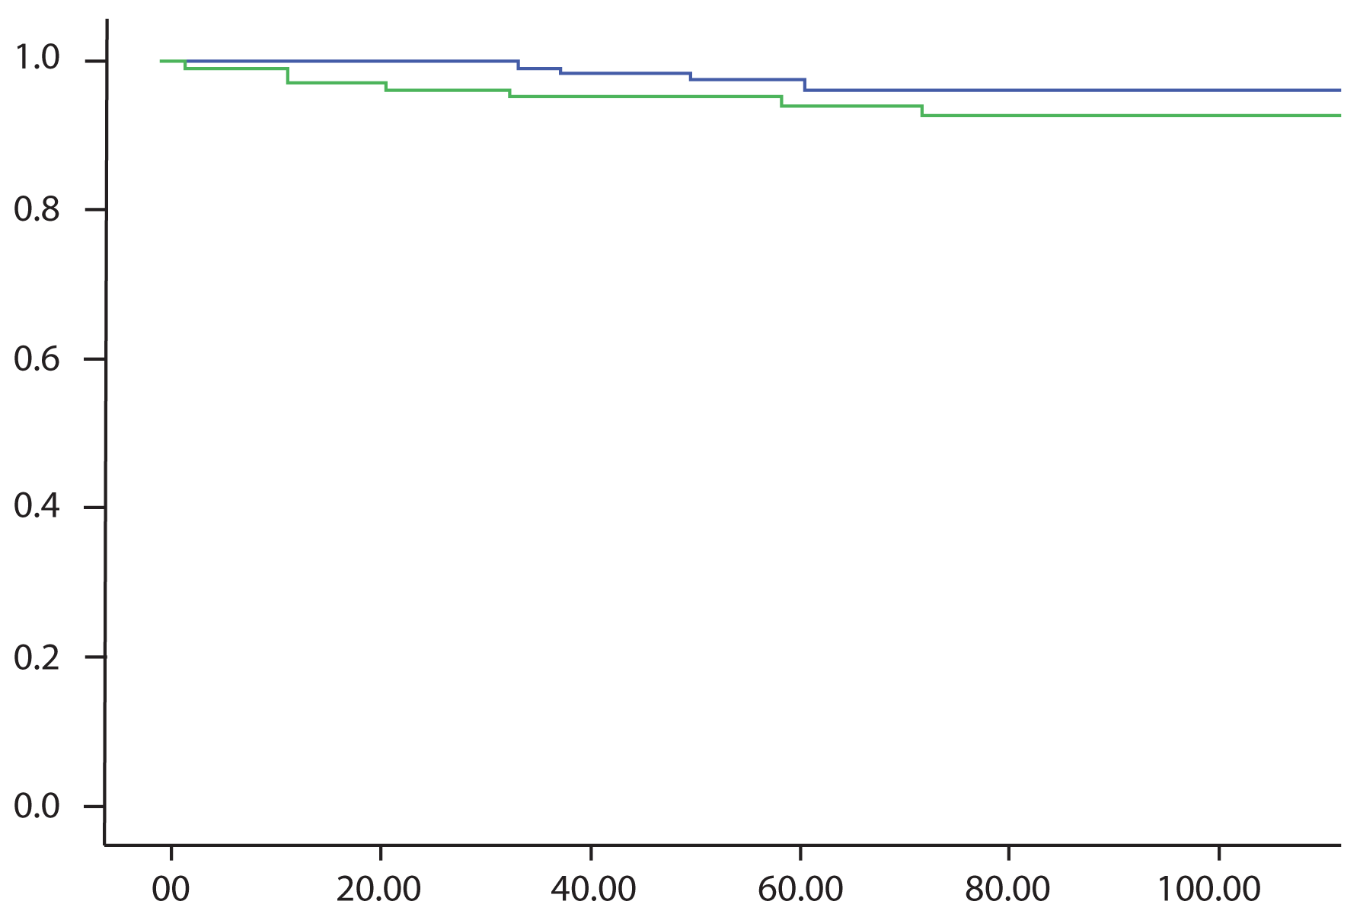
Figure 2
BITA group
Freedom from TVR
Single LITA group
Log rank test (5-year)
BITA VS | 97.1 ± 0.01% | p=0.042
Single LITA | 94.4± 0.02 %
Survival time (months)

