Slide 1
Table 1. Characteristics of patients
Parameters |  | Numerical value
Age (yrs) |  | 62.0 ± 16.0
Gender | Male | 13 (68.4%)
 | Female | 6 (31.6%)
Underlying disease
Chronic renal insufficiency Diabetes mellitus Hypertension Tumor |  | 4 6 5 2
Aneurysmal site
Ascending Descending thoracic Thoracoabdominal Abdominal |  | 3 (15.8%) 6 (31.6%) 2 (10.5%) 8 (42.1%)
Related symptoms
Fever Pain Hematochezia, hemoptysis Extremities weakness None |  | 8 (42.1%) 10 (52.6%) 4 (21%) 2 (10.5%) 1 (5.3%)

Slide 2
Table 2. Culture analysis
Cultures | Numeric values
MSSA | 4
Gram positive | 1
Gram negative | 5
None | 8

Slide 3
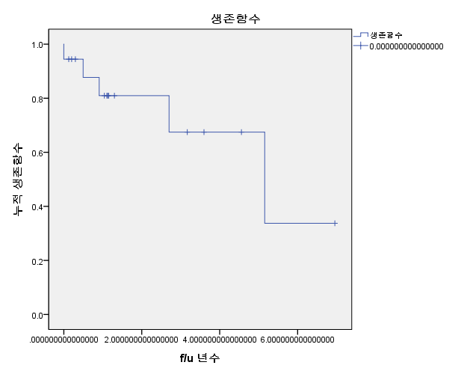
Figure 1. Survival curve

Slide 4
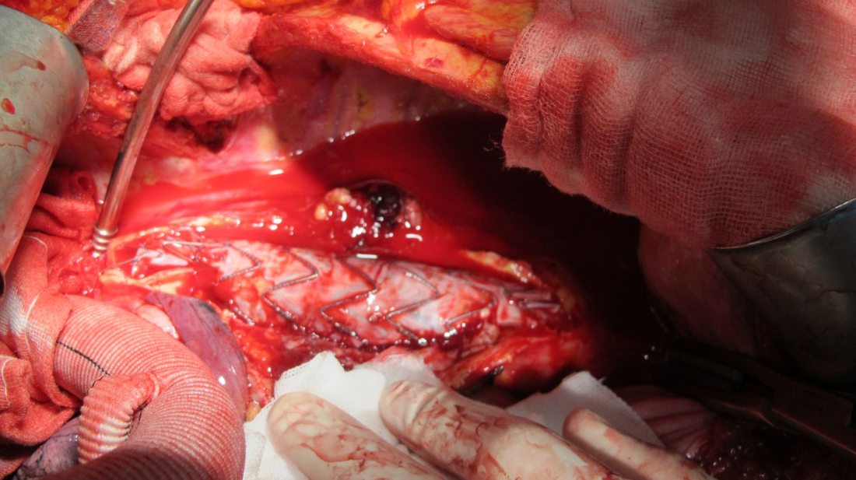
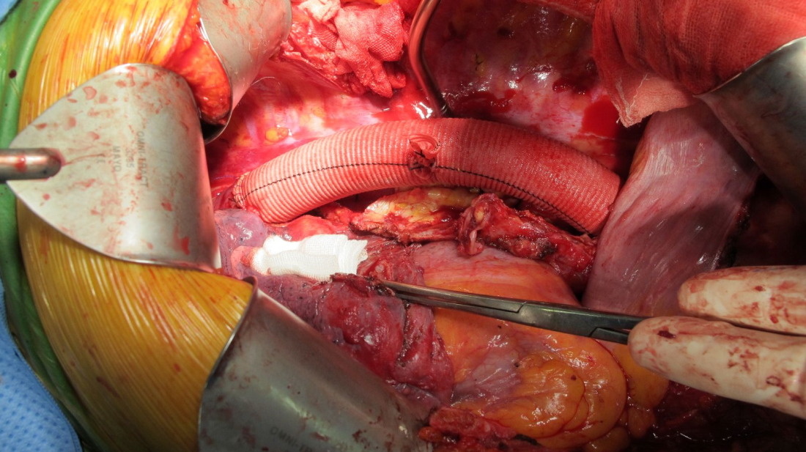
Figure 2. OP technique
(Prosthetic Dacron graft)

Slide 5
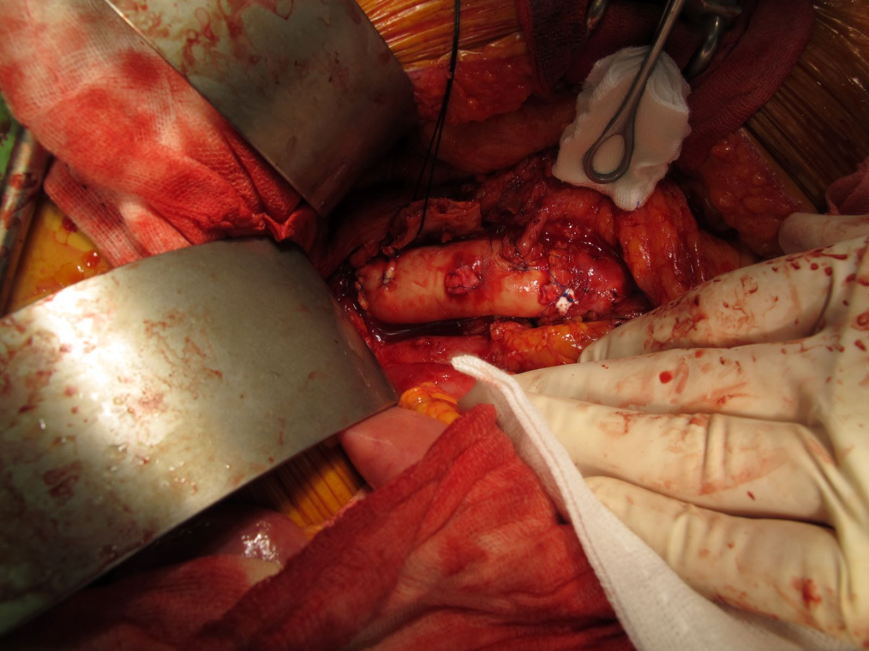
Figure 3. OP technique (Homograft)

