Slide 1
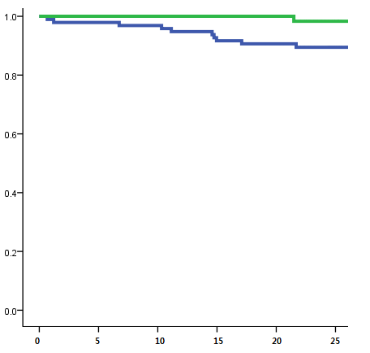
PVR
Survival rate
non-PVR
Years after ToF repair

