Slide 1
Novel surgical technique for the prevention of pulmonary arteriovenous malformations in left isomerism

Slide 2
Purpose
In patients with left atrial isomerism (LAI), poor mixing of the hepatic venous flow to the pulmonary artery ipsilateral to the azygos (or hemiazygos) vein after the Kawashima operation (KO) or the completion Fontan operation (FO) may lead to the development of pulmonary arteriovenous malformation (PAM) in the corresponding lung. To address this issue, we developed technical modifications for KO and the completion FO.

Slide 3
Methods
Four patients with LAI underwent modified KO and, among them, three proceeded to the completion FO. Their age at KO and completion FO were 17-19 months and 38-50 months, respectively. Technical modification for KO was the anastomosis of the dominant superior vena cava (SVC) or the innominate vein to the geometric center of the pulmonary artery to allow even distribution of the pulsatile forward flow from the heart to the both lungs. Technical modification of Fontan completion was the anastomosis of the extracardiac conduit to the dominant SVC or geometic center of the pulmonary artery to guarantee the even distribution of the hepatic venous return to the both lungs.

Slide 4
Results
There was no postoperative mortality or morbidity. In three patients with completion FO, post-Fontan magnetic resonance image or computed tomography showed no pulmonary arteriovenous malformations and even distribution of the hepatic venous flow to the right and left lungs.

Slide 5
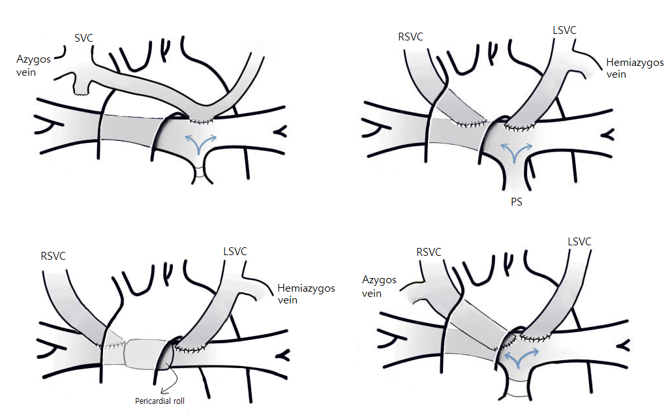

Slide 6
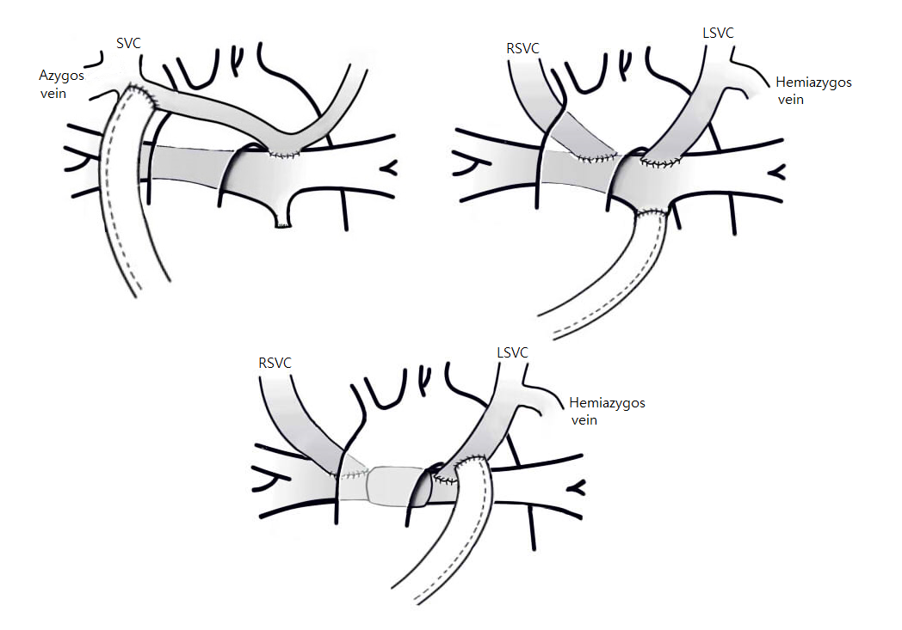

Slide 7
Conclusion
This novel surgical approach may provide a reliable mixing and bilateral distribution of hepatic venous blood in this subset.

