Slide 1
Prevention of limb ischemia in children with VA ECMO through femoral artery

Slide 2
Purpose
Limb ischemia after FA cannulation for VA ECMO : 10 - 50%
  Pediatric patients : up to 52% ( Gander et al. J Pediatr Surg. (2010) )
Suggested prevention strategies in adults
    Distal perfusion
    Side – arm graft technique
Pediatric patient, there is little experience :
    Distal perfusion catheter in SFA ( Schad et al. Artifical organs (2017) )
    Side – arm graft : No published report
Since 2007, we have applied side-arm graft technique
Does side-arm graft have effect on prevention of limb ischemia?

Slide 3
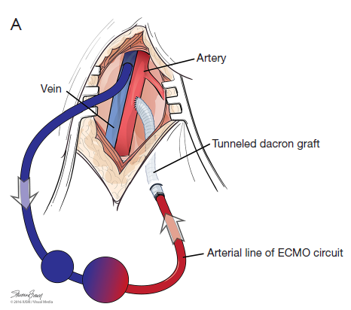
Methods
Retrograde review of pediatric patients with VA ECMO
January, 2004 ~ December, 2016
85 VA ECMO out of 149 pediatric ECMO cases
Central ECMO and Peripheral VA ECMO via neck approach cases were excluded.
Femoral artery cannulation : 39 cases
  Direct cannulation : 15 cases
  Distal perfusion : 13 cases
  Side arm graft : 11 cases

Slide 4
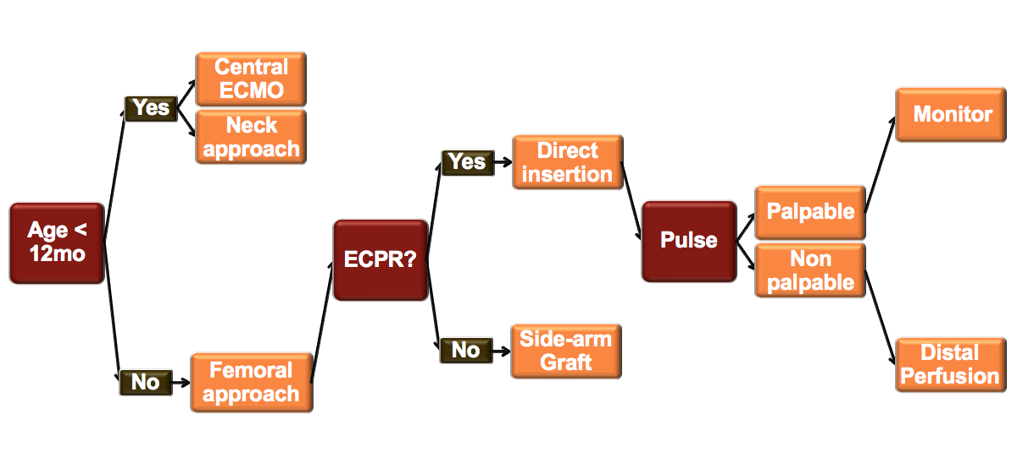
Methods

Slide 5
Results
 | Direct Cannulation | Distal perfusion | Side-arm Graft | P-value
Basal Characteristics
Age, y | 11.7 ± 4.66 | 12.9 ± 3.90 | 7.9 ± 4.99 | 0.029
Male, n (%) | 8 (53.3%) | 9 (69.2%) | 6 (54.5%) | 0.653
Weight, kg | 39.6 ± 21.1 | 50.8 ± 15.7 | 24.5 ± 10.2 | 0.002
Height, cm | 142.6 ± 27.1 | 154.4 ± 23.3 | 122.1 ± 26.3 | 0.014
BSA, m2 | 1.22 ± 0.43 | 1.46 ± 0.33 | 0.9 ± 0.28 | 0.002
Arterial cannula size, F | 14.3 ± 3.2 | 14.7 ± 3.3 | 14.2 ± 2.6 | 0.906
Diagnosis
Cardiopulmonary arrest | 9 (60.0%) | 5 (38.5%) | 3 (27.3%) | -
Cardiogenic shock | 4 (26.7%) | 6 (46.2%) | 7 (63.6%) | -
Respiratory failure | 0 (0%) | 2 (15.4%) | 1 (9.1%) | -
Septic shock | 1 (6.7%) | 0 (0%) | 0 (0%) | -
Others | 1 (6.7%) | 0 (0%) | 0 (0%) | -

Slide 6
Results
 | Direct Cannulation | Distal Perfusion | Side-arm Graft | P-value
E-CPR | 6 (40%) | 2 (15.4%) | 1 (9.1%) | 0.190
Cannula-BSA ratio | 11.4 ± 2.76 | 10.2 ± 2.30 | 16.73 ± 3.98 | 0.000
Limb ischemia, n (%) | 3 (20%) | 2 (15%) | 0 (0%) | 0.406
Weaning Success, n (%) | 10 (66.7%) | 8 (61.5%) | 9 (81.8%) | 0.620
Discharge Success , n (%) | 9 (60%) | 4 (30.8%) |  | 0.314
Mortality | 7 (46.7%) | 9(69.2%) | 5(45.5%) | 0.394
Among 39 patients, 5 patients underwent limb ischemia
No limb ischemia in side-arm graft group
All the patients who had limb ischemia died

Slide 7
Conclusion
Side-arm graft technique can help to apply appropriate size arterial catheter in pediatric VA ECMO patients with femoral artery cannulation.
Although the results were not statistically significant, side-arm graft technique tend to result in less limb ischemia.
We recommend side-arm graft technique in small children for sufficient blood flow and prevention of limb ischemia.

