Slide 1
Search for the ideal Conduit:
Our experience with Homemade expanded polytetrafluoroethylene valved conduit

Slide 2
Purpose
A wide range of congenital heart diseases require right ventricular outflow tract reconstruction (RVOTR) with valved conduits.
However the ideal choice for a valved conduit has yet to be found.
Since 2008, we have implanted homemade tri-leaflet conduits made of expanded polytetrafluoroethylene (ePTFE).

Slide 3
Methods
From 2008 to 2016
77 homemade ePTFE valved conduits in 68 patients
Follow-up loss : 2 foreign patient
66 patients (97.1%)
Mean f/u period : 2.91±2.39 years
      In-hospital mortality : 0
      Late term mortalities : 3 (sepsis & pneumonia)

Slide 4
Results
Patient characteristics
Mean age at operation | 4.4±4.16 (years) (range 19 days to 14 years)
Mean body weight at operation | 16.7±13.36 (kg)
Mean conduit size | 16.1±3.38 (mm)
Pulmonary annulus z-score | 1.07±1.04
Conduit size (mm) | 10 | 12 | 14 | 16 | 18 | 20 | 22 | 24
Numbers (n=77) | 3 | 12 | 16 | 18 | 11 | 9 | 7 | 1
Re-intervention | N=17
Balloon valvuloplasty/angioplasty | 9
Rastelli operation | 13
Balloon + operation | 5

Slide 5
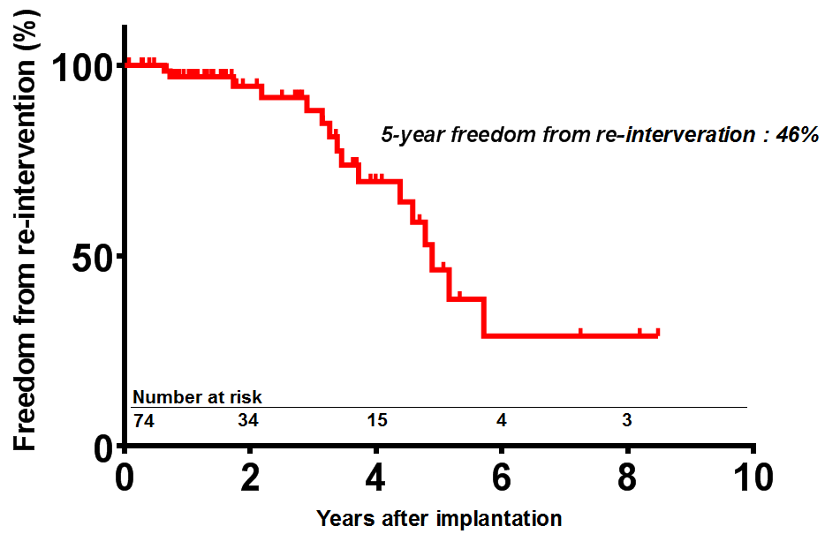
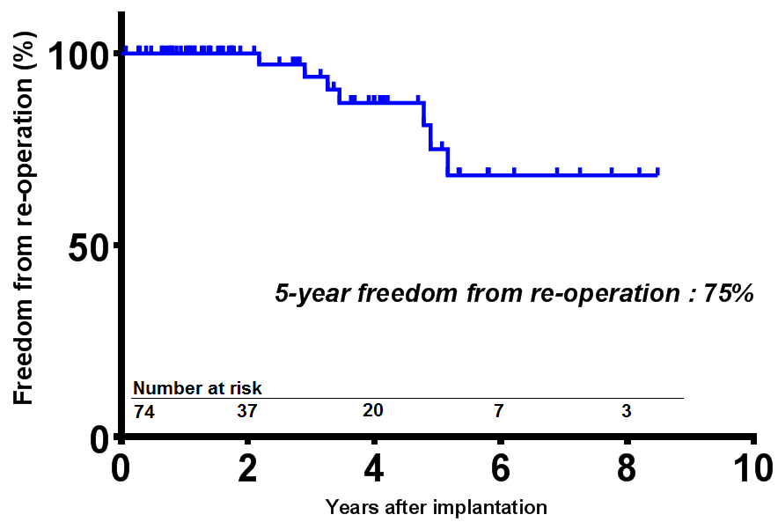
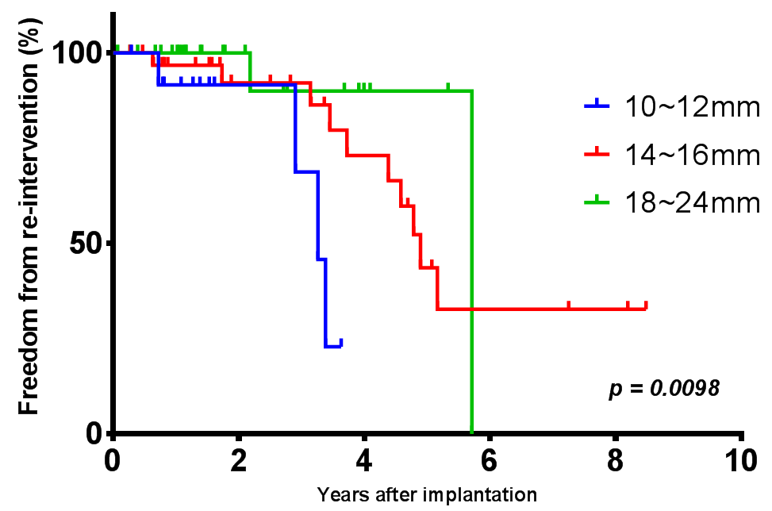
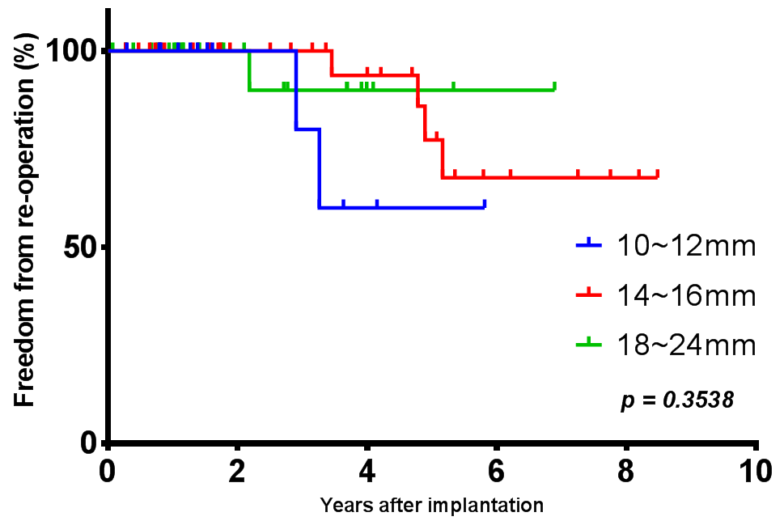
Results
Overall freedom from reoperation and re-intervention at 5 years was 75% and 46%, respectively.
Re-intervention for conduit stenosis was more frequent in small-sized conduits. However, re-operation rate showed no difference.

Slide 6
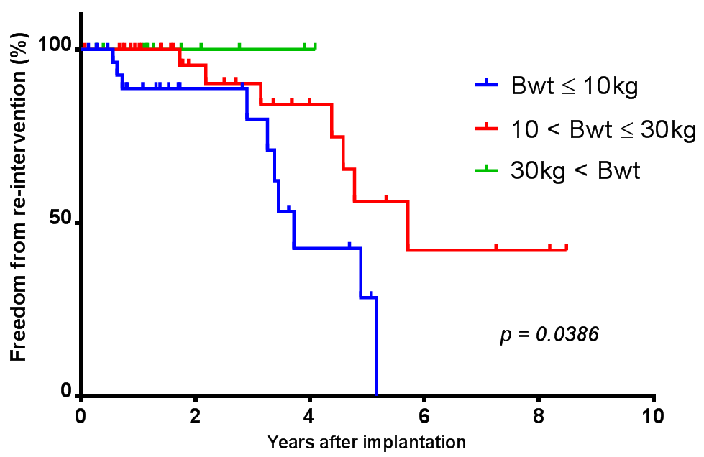
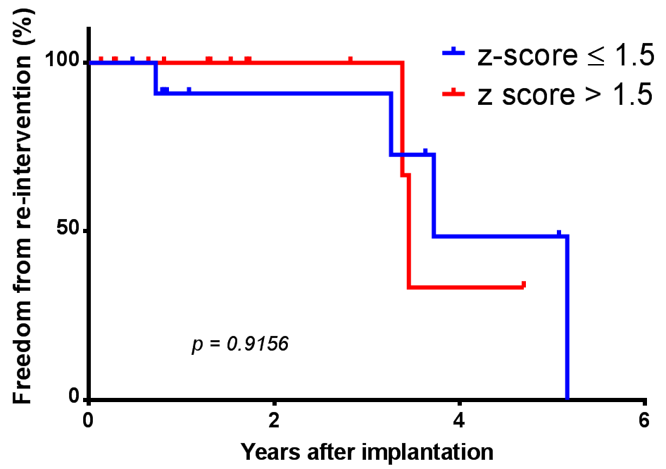
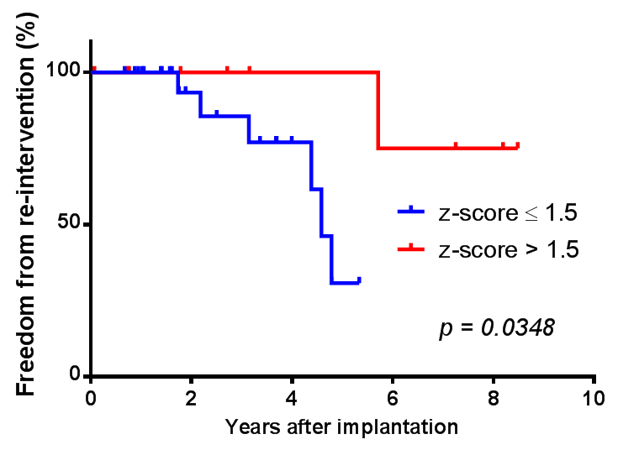
Results
Risk-factors for re-intervention :
  age, body weight, small sized conduit
In small patients (≤10kg),
relatively larger conduits
with bigger pulmonary z-score (>1.5)
didn’t last longer
However in 10~30kg patients,
conduits with bigger z-score
tended to require fewer re-intervention

Slide 7
Conclusion
Homemade ePTFE valved conduits can provide a good alternative for RVOT reconstruction especially in small in children.
Implanting an oversized conduit in small children (≤10kg) showed no benefit.
Longer follow-up is needed to determine how the larger ePTFE conduits will fare compared to commercialized prosthetic valves.

