Slide 1
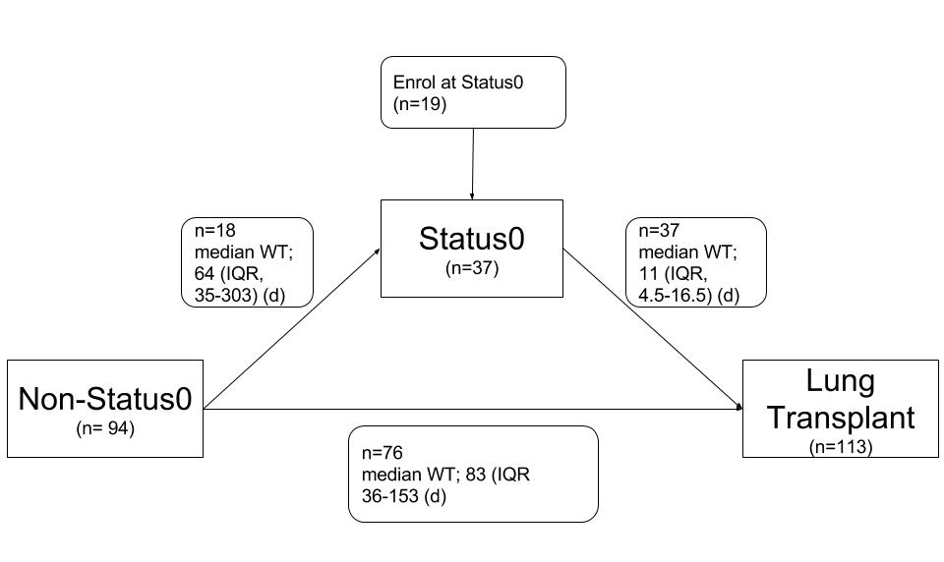
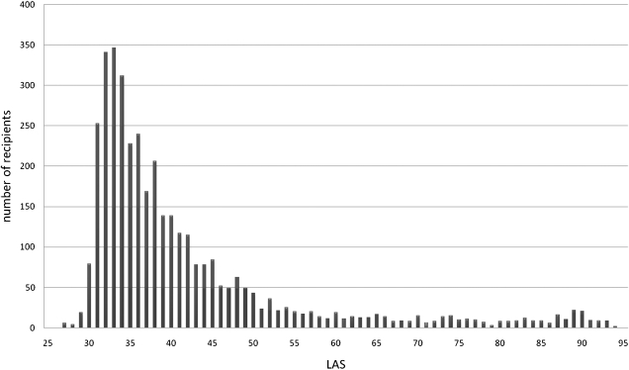
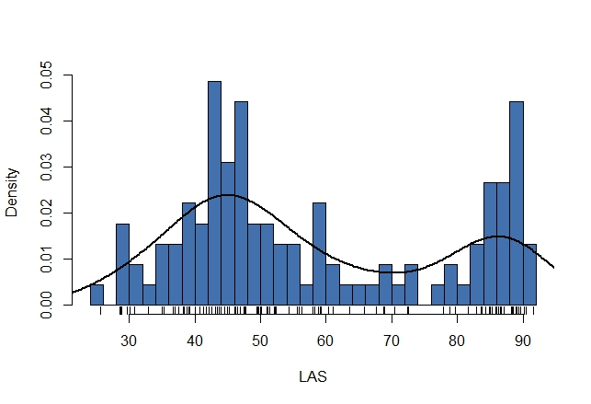
A
B
C
Distribution of LAS of the UNOS (top), (Russo MJ et al., High lung allocation score is associated with increased morbidity and mortality following transplantation.
chest, 2010) and our cohort (bottom)

