Slide 1
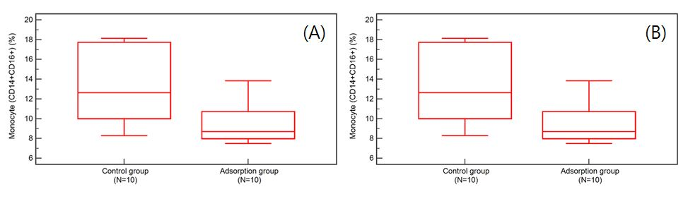
Figure 1. The results of flow cytometric analysis in 2 groups.
A) The ratio of total monocyte (CD14+)
B) The ratio of classical type in monocyte subsets (CD14+CDC16+).

Slide 2
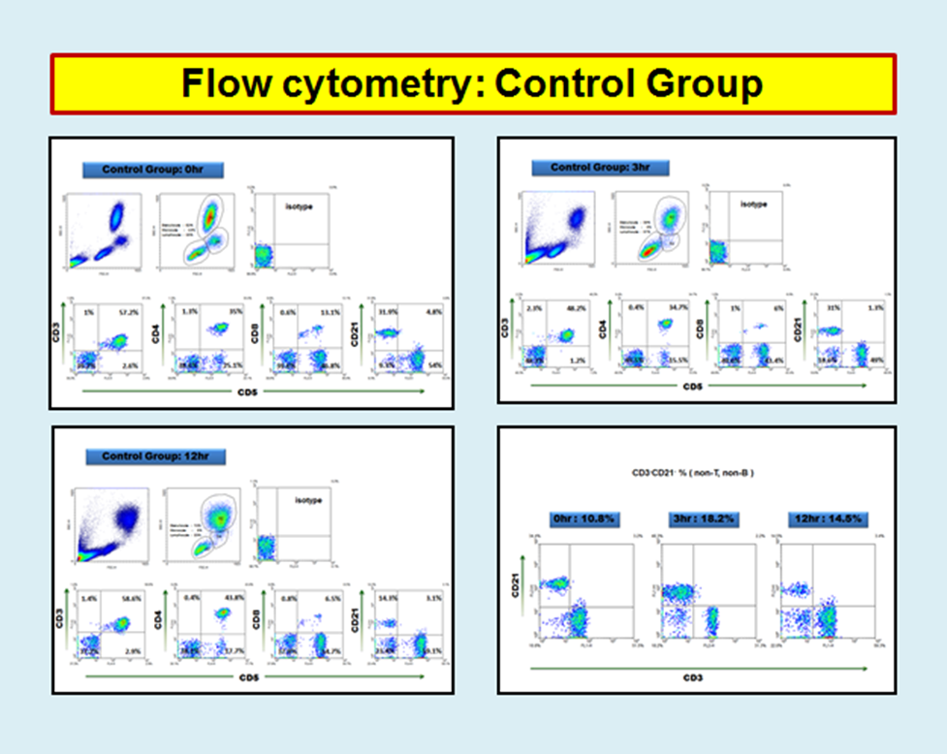
Figure 2. flow cytometry : control group

Slide 3
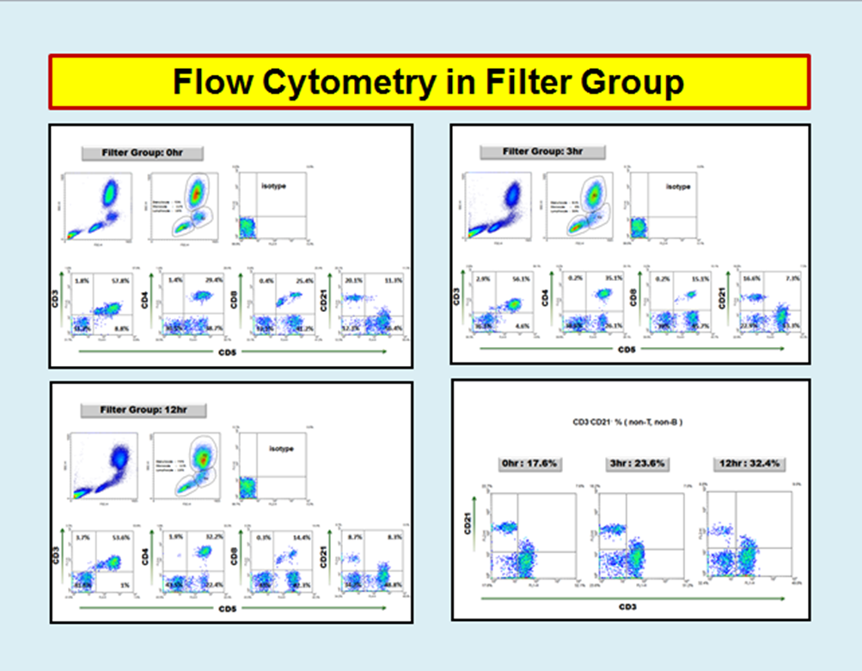
Figure 3. flow cytometry : filter group

