Slide 1
Impact of prenatal diagnosis on the outcome of absent pulmonary syndrome

Slide 2
Purpose
To investigate risk factors for mortality in fetuses and infants with absent pulmonary syndrome (APV)

Slide 3
Methods
Fetal and postnatal echocardiographic database and clinical records of all patients with APV
Between 2002 and 2016 were reviewed retrospectively

Slide 4
Results
25 patients
- 20 patients (20/25, 80%) with tetralogy of Fallot
- Two (2/25, 8%) with isolated APV
- Three (3/25, 12%) with single ventricle physiology
19 patients were prenatally diagnosed
- Ten fetuses were lost to follow-up or terminated
- One fetus died in utero
- Four fetuses experienced early postsurgical deaths during infancy
- Four patients survived
All who were diagnosed postnatally survived
Two fetuses with dysplastic tricuspid valve had hydrops fetalis

Slide 5
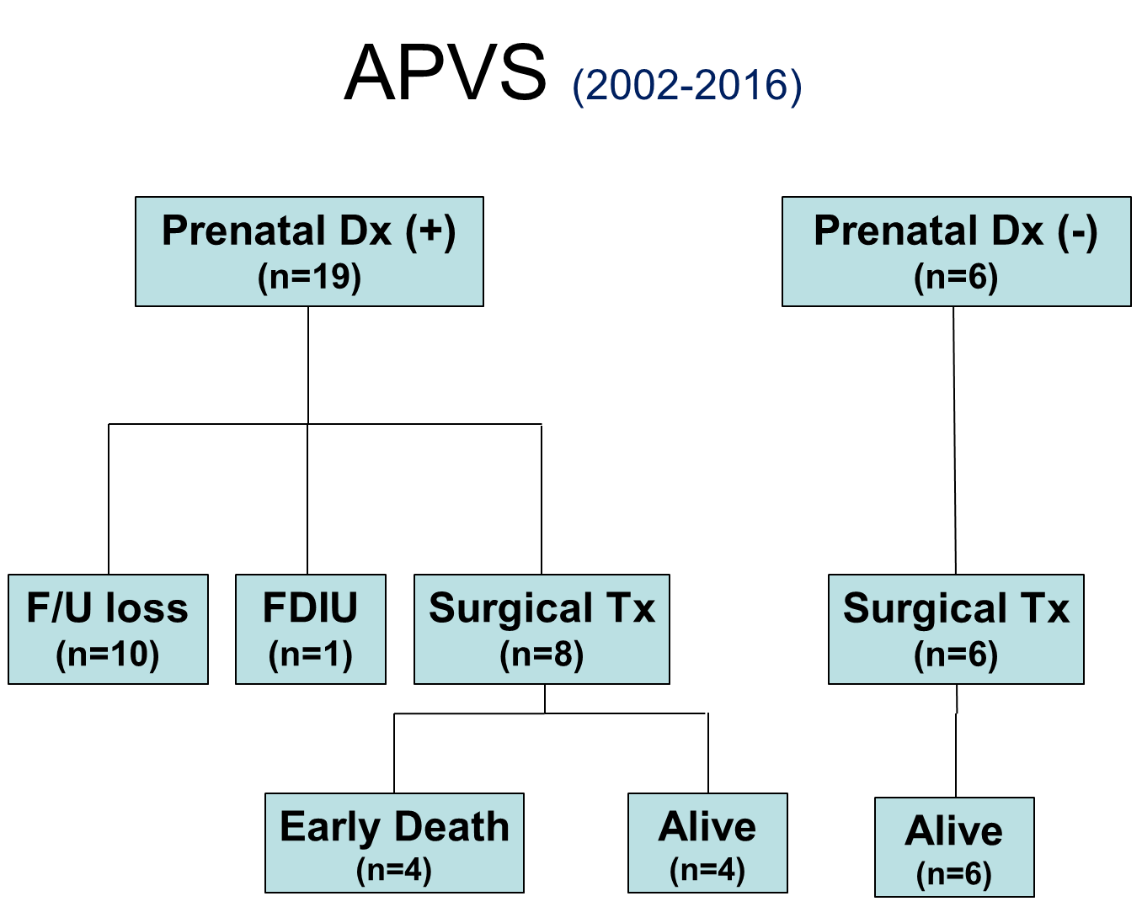
Results

Slide 6
Results
Index
- main, right, and left pulmonary artery diameters
- right ventricle size/ left ventricular size
- right atrial diameter / left atrial diameter
- tricuspid annular size/ mitral annular size
- peak velocity of pulmonary stenosis or regurgitation
→ No differences between the survivors and non-survivors on fetal echocardiography
Pulmonary valve annulus size to aortic valve annulus size ratio was larger in non-survivors without statistical significance (1.01 ± 0.35 vs. 0.78 ± 0.11; P = 0.183)
Underlying single ventricular physiology (R² =0.355, P =0.019) and right or left ventricular dysfunction (R²=0.5, P =0.003) predicted postsurgical death

Slide 7
Conclusion
APV appear poor, especially in patients with prenatal diagnosis, single ventricular physiology, and right or left ventricular dysfunction.

