Slide 1
Pulmonary Artery Banding in Very-low-birth-weight Premature Infants in Neonatal Intensive Care Unit

Slide 2
Introduction
Pulmonary artery banding
  For control excessive pulmonary blood flow
Very-low-birth-weight premature infants
  Intubated
  Monitoring & Drug-infusion lines
PDA ligation in the intensive care units has reported excellent results , but pulmonary artery banding in the ICUs which little is reported.
To eliminate the risks associated with transportation, we perform the operation in the neonatal intensive care unit (NICU).
Notes:
J Cardiothorac Surg. 2012 Dec 12;7:129

Slide 3
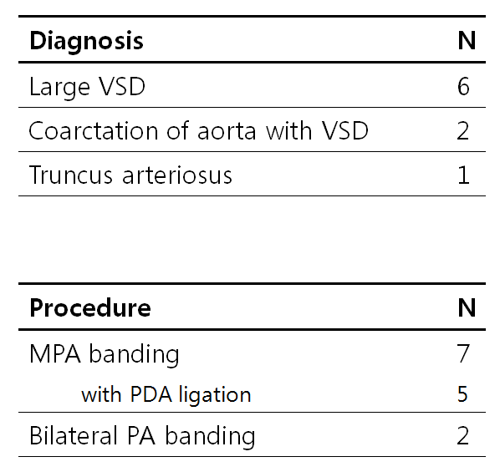
Methods
Between May 2007 – May 2017
9 infants
  5 male / 4 female
  At birth
    Mean GA 32+4 weeks
    (range, 26+6 – 38+1)
    Mean bodyweight 1.41 kg
    (range, 0.72-1.93)
  At operation
    Mean age 16 days (range, 6-36)
    Mean bodyweight 1.45kg
    (range, 0.72-1.91)

Slide 4
Methods
Monitoring
  Essential requirement : Saturation monitoring
  Option : A-line, C-line
Surgical procedures
  Median sternotomy with blade
  Pulmonary artery banding with
    Gore-tex strip
    Umbilical tape
    Vessel loop
  J-P drain
  Sternum approximation with Vicryl and/or steel wire

Slide 5
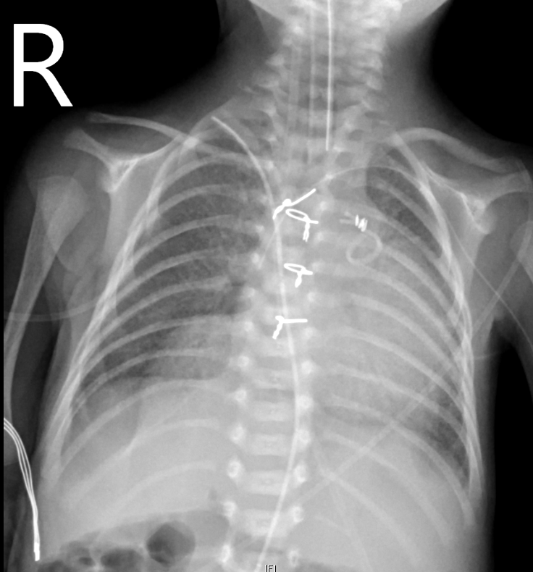
Methods

Slide 6
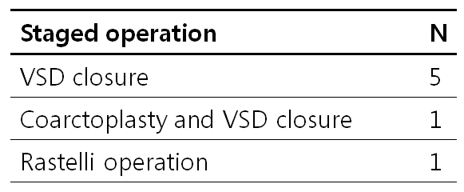
Results
Mean follow up duration : 28.44 months (range, 2-97)
Mean interval between PAB to staged OP
: 5.1 months (range, 2-9)
9 patients
7 patients had staged OP
1 patient
in hospital death :
NEC, heaptic failure
POD # 59
1 patient
MPA debanding
POD # 124

Slide 7
Conclusion
Safe and effective to perform bedside pulmonary artery banding in the NICU
Team approach is important
  Cardiac surgeon
  Pediatric cardiologist
  Neonatal intensive care specialist
  Scrub and circulating nurse
  NICU nurse

