Slide 1
Excellent Durability and Bothersome Events after Mechanical Pulmonary Valve Replacement
공지사항
  소속기관이나 저자명이 드러나지 않도록 해주세요
  제목 슬라이드 제외 최대 6장, Font size 20 이상
  사진/illustration등으로 인해 용량이 큰 경우 PDF로 전환해서 접수

Slide 2
Purpose
A mechanical prosthesis plays a role in pulmonary valve replacement (PVR) to avoid multiple reoperations.
However, thromboembolic risk and bleeding complications are major drawbacks for mechanical PVR.
The aim of this study is to investigate outcomes of mechanical prosthetic valves in pulmonary position in a single center.

Slide 3
Methods
Patients
  Patients who underwent mechanical PVR between January 2005 and December 2015
Retrospective analysis
Outcomes
  Survival
  Prosthetic valve failure
    Thrombosis
    Pannus formation
  Anticoagulation related problems
    Bleeding
    Repeated admission to control prothrombin time

Slide 4
Results
N=46
Baseline Characteristics
Male sex | 37 (80%)
Age at PVR, range | 11 – 55 years
Follow-up duration (range) | 8.6 ± 0.5 years
Prosthetic valve failure (N=3, 7%)
Thrombosis Pannus formation By method of implantation in-graft direct | 2 1 2 1

Slide 5
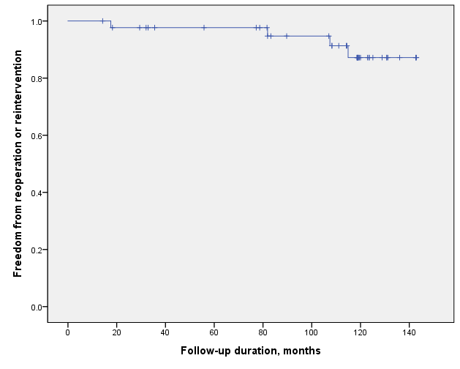
Results
Outcomes
Reoperations Reinterventions leaflet mobilization thrombolysis | 2 2 1 1
5 -year | 98%
7 -year | 95%
10-year | 87%

Slide 6
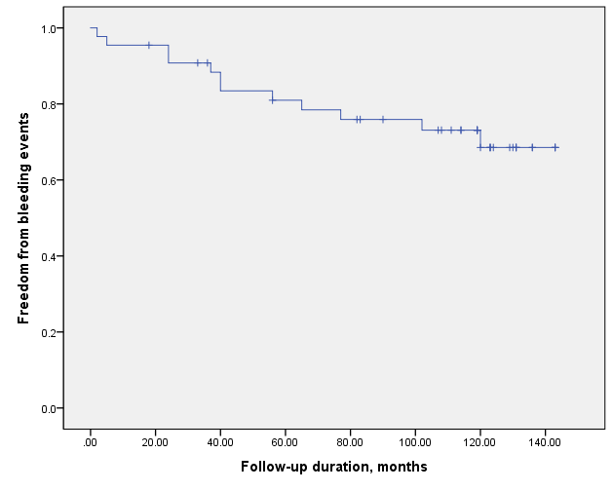
Results
Major bleeding complications (N=12, 26%)
Intracranial hemorrhage Vaginal bleeding Hemoptysis Hematuria Hematoma | 2 1 1 3 5
5 -year | 81%
7 -year | 86%
10-year | 69%
1/3 of the patients required hospital admissions to control prothrombin time.
1/3 of them required multiple admissions.

Slide 7
Conclusion
Pulmonary valve replacement using mechanical prosthesis may be a reasonable solution to avoid multiple reoperations with low risk of pannus formation or thrombosis.
Re-operation and re-intervention rates were low.
However, rates of bleeding complications were higher than previously reported.
Need for admission for anticoagulation control was not uncommon.
Therefore, mechanical pulmonary valve replacement should be performed in highly selected patients.

