Slide 1
Early and Late Outcomes after Late Bidirectional Cavopulmonary Shunt
공지사항
  소속기관이나 저자명이 드러나지 않도록 해주세요
  제목 슬라이드 제외 최대 6장, Font size 20 이상
  사진/illustration등으로 인해 용량이 큰 경우 PDF로 전환해서 접수

Slide 2
Purpose
Surgical timing of staged palliation is important in patients with a single ventricle.
However, still there is considerable number of patients who did not receive timely palliation due to various reasons.
Studies on patients undergoing bidirectional cavopulmonary shunt (BCPS) beyond their infancy are limited.
This study is to evaluate the outcomes after late BCPS and their associated factors.

Slide 3
Methods
Patients
  who underwent BCPS after the first year of their lives between December 1990 and April 2016
Medical records of were retrospectively reviewed.
Patients with one-and-a-half ventricle procedure were excluded from the study.

Slide 4
Results
51 patients
Median age: 25 months (range, 12 months – 25 years)
Early outcomes
  Two early deaths
  1/3 of the patients needed pulsatility in addition to the cavopulmonary shunt.
Age at BCPS | Numbers (%)
12-24 months | 24 (47%)
24 months- 10 year | 20 (39%)
> 10 year | 7 (14%)

Slide 5
Results
Long-term outcomes
  Fontan completion
    Thirty-eight (75%) patients were able to proceed to Fontan completion without difficulty.
    The median age at Fontan completion was 4 years (range, 3 – 27 years).
    Fenestration was made in 26 (68%) patients.
    The mean Fontan pressure at follow-up was 17 mmHg.

Slide 6
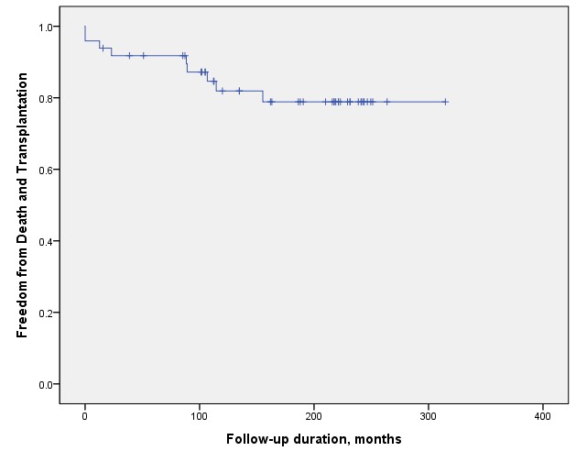
Results
Long-term outcomes
  Late deaths in 6 patients
  Heart transplantation in 2 patients
  Freedom from death or transplantation was 92% and 82% at 5-year and 10-year, respectively.
Age at BCPS was not a risk factor for death or transplantation.
However, the age at BCPS was a predictor for Fontan completion (odds ratio, 0.99; p = 0.02)

Slide 7
Conclusion
Late bidirectional cavopulmonary shunt is associated with poor long-term survival and low chance of Fontan completion.
However, death or transplantation was not associated with the age at BCPS.
Fontan take-down was a strong risk factor for late death.
Therefore, heart transplantation instead of Fontan completion should be considered as a reasonable option for patients after late BCPS with high risks.

