Slide 1
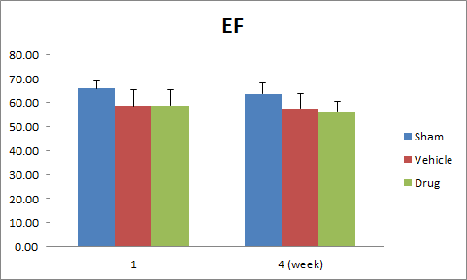
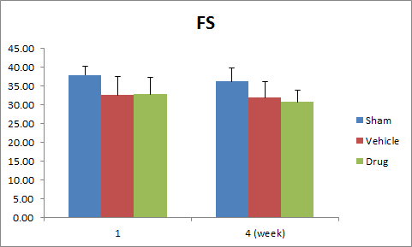
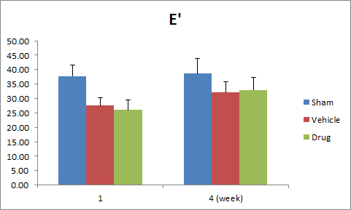
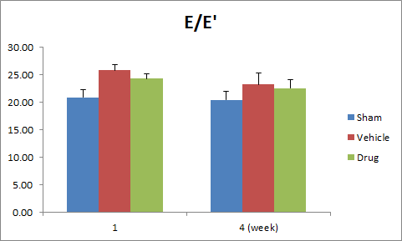
Figure1. Sham group showed statistically significant better systolic and diastolic
function than any other group. Compared with vehicle and treatment groups in terms
of systolic and diastolic function of heart, systolic function between two groups were
not significantly different at any point. However, diastolic function between vehicle
and treatment groups showed significantly different at 1 week.

