Slide 1
Long-term outcome of homograft monocusp valve inserted during repair of tetralogy of Fallot

Slide 2
Purpose
To maintain pulmonary valvar function subsequent to repair of tetralogy of Fallot, we have inserted a homograft monocusp when a transannular patch was required.
In this study, we have evaluated long term outcomes and durability of a homograft monocusp.

Slide 3
Methods
February, 2000-December, 2015 ; retrospective study
Total 442 patients underwent TOF repair.
Total correction with TAP – homograft monocus patch
→ 104 patients
Median age : 6.7 months (range, 11 day to 10.8 years)
Median weight : 7.6 kg (range, 2.6 to 26kg)
Double outlet right ventricle
Atrioventricular septal defect
Pulmonary atresia with VSD
Absent pulmonary valve syndrome
Excluded

Slide 4
Results
No early mortality
Median duration of mechanical ventilation : 1 day (range, 0 to 89) Median hospital stay was 6.5 days (range, 2 to 137)
Follow up duration : 7.0 ± 5.1 years
Two late mortality - Sepsis (n=1)
- Respiratory arrest (n=1)
 | At discharge | At last F/U
Significant PS | 0 | 1
Significant PR | Moderate PR (2) | Moderate PR (19, 1.2%)
 | Severe PR (0) | Severe PR (42, 40.3%)

Slide 5
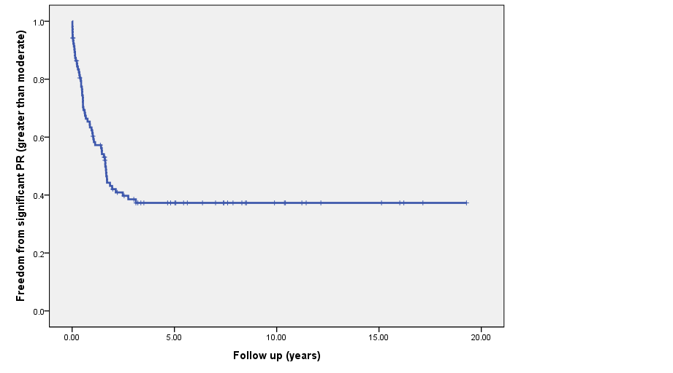
Results
Actuarial freedom from PR greater than moderate
At 1-month : 92.3%
At 3-month : 84.4%
At 12-month : 61.3%

Slide 6
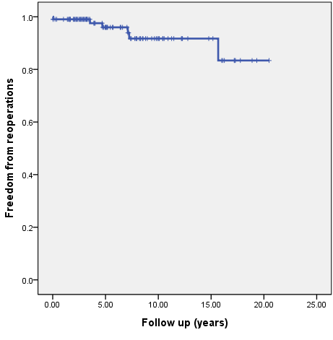
Results
Actuarial freedom from reoperation (PVR) – 7 patients
At 3-year : 100%
At 5-year : 96.0%
At 10-year : 91.7%

Slide 7
Conclusion
The homograft monocusp valve patch for right ventricular outflow tract reconstruction has provided excellent early results for the prevention of pulmonary insufficiency.
In long term outcome, homograft monocusp function decreases over time as the RVOT grows and the homograft tissue undergoes structural deterioration.
In order to know the benefit of homograft monocusp for this group of patients, it is necessary to clarify the relationship of avoiding PR in early period to RV dysfuction.

