Slide 1
Pulmonary artery growth after Surgical management of pulmonary artery sling

Slide 2
Purpose
Pulmonary artery sling is a rare vascular ring and commonly associated with tracheal stenosis.
The ideal treatment of pulmonary artery sling remains controversy and there is little data about
growth of pulmonary artery.
The aim of this study was to evaluate the clinical outcomes with emphasis on growth of pulmonary artery after surgical managements.

Slide 3
Methods
From 1996 to 2016, retrospective reviewd
25 patients – repair PA sling
median age, 2.7 months ; range, 2 days to 34.4 months
median weight : 5.7 kg ; range, 1.9 to 57 kg
Concomitant cardiac lesions
atrial septal defect (6)
ventricular septal defect (3)
coarctation of aorta (1)

Slide 4
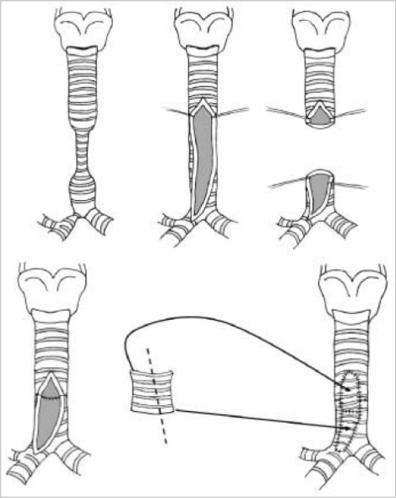
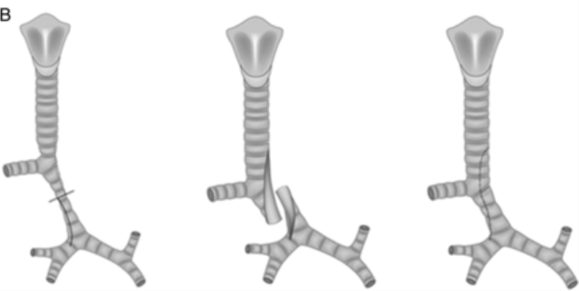
Results
25 Patients
22 Patients
LPA reimplantation with tracheoplasty
2 Patients
LPA reimplantation alone
autologous graft or pericardial patch tracheoplsty
slide tracheoplasty
N=6
N=16

Slide 5
Results
Follow up duration : 5.6 ± 4.1 years
3 hospital death -> sepsis with tracheal disruption (2)
-> respiratory failure (1)
one late death -> non-cardiac origin
4 reoperations and 2 reintervention
bronchoscopy with removal of granulation tissue (2)
aortopexy (1)
diaphragm plication (1)
LPA angioplasty (1)
LPA Balloon dilatation (2)

Slide 6
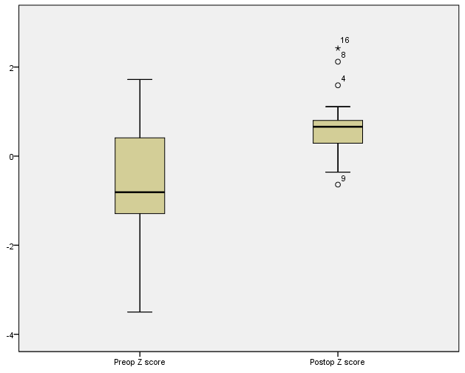
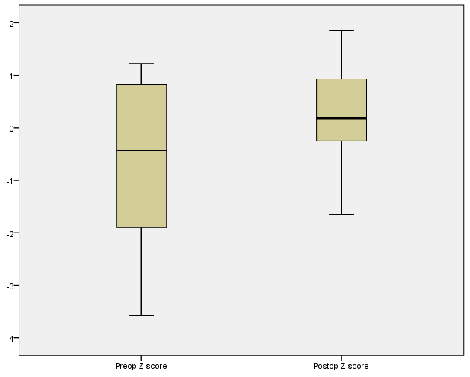
Results- Growth of PAs
Variables | PreOP | PostOP (4 years after the OP) | p
RPA Z score | -0.61 ±1.32 | 0.66 ±0.80 | 0.003
LPA Z score | -0.59 ±1.46 | 0.22 ± 0.93 | 0.09
LPA/RPA | 0.94±0.19 | 0.82±0.14 | 0.083
Z score change (RPA)
Z score change (LPA)
p =0.003
p =0.09

Slide 7
Conclusion
Left pulmonary artery reimplatation with simultaneous repair of tracheal stenosis and intracardiac anomalies results in low operative mortality and satisfactory left pulmonary artery patency.
The change of LPA Z score was not significant, the balanced growth between LPA and RPA was identified.

