Slide 1
Long-term result of atrioventricular valve surgery in patients with functional single-ventricle : should we avoid valve replacement?

Slide 2
Purpose
Atrioventricular valve regurgitation (AVVR) associated with increasing morbidity and mortality in patient with single-ventricle physiology.
Successful regurgitation correction is well known improving long-term outcomes. But successful valve repair is not always possible.
The purpose of this study
  To evaluate long-term result of surgical management of AVVR
  To analyse characteristics of patients got valve replacement for AVVR

Slide 3
Patients
January 2001 – March 2018 : 233 patients with single-ventricle palliation
  AV valve surgery more than once (n=38)
    Repair (n=30), Replacement (n=8)
    Heterotaxia : 21/38 (55.3%)
Surgery timing (n) : before Fontan (16), Fontan (10), after Fontan (12)
Median follow-up : 8.1 years (range 0.08-18.2)

Slide 4
Methods
Indication of AVV surgery : moderate to severe AVVR
Compared the patients who got valve replacement initially for AVVR with other patients.
Evaluated clinical outcomes
  Freedom from death, reoperation and valve related event
Patients’ characteristics
  ventricle type, valve type, timing of surgery and ventricular dysfunction, heterotaxia

Slide 5
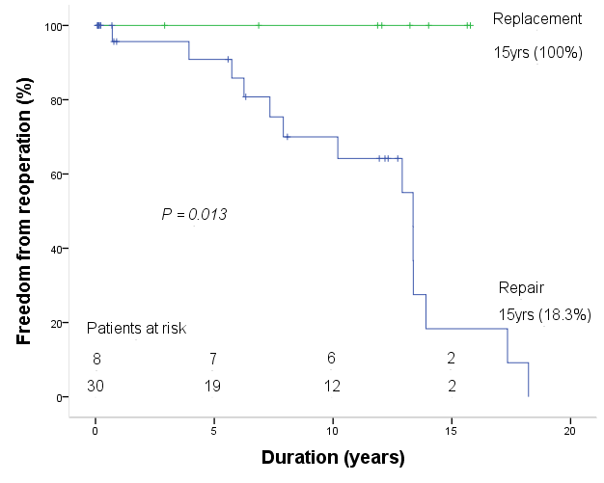
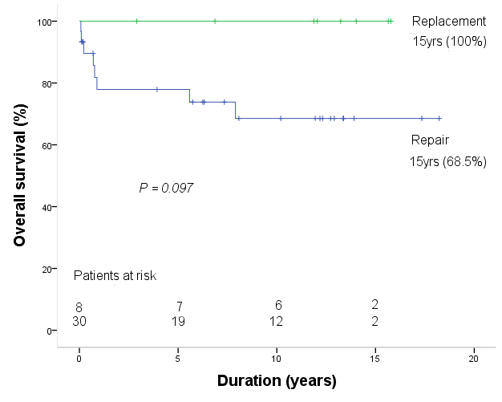
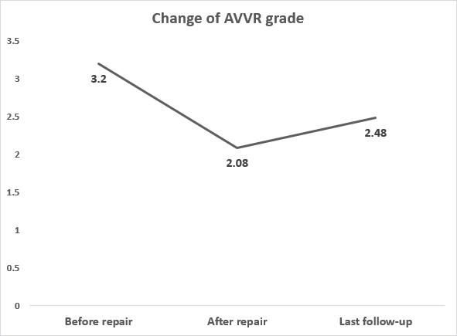
Results
Operative results
  Mortality : 8/38 (21.1%), Mortality before Fontan : 3/38 (7.8%)
  Valve related event : 1/38 (in replacement, paravalvular leakage)
  Ventricular dysfunction before valve surgery (n=10, p=0.653)
    repair (n=9, 30.0%), replacement (n=1, 12.5%)

Slide 6
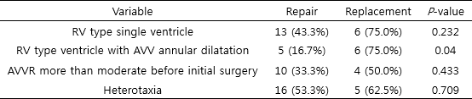

Results
Risk factors for AVV replacement
  Univariate analysis
  Multivariable analysis
    Variables for multivariable analysis : RV type single ventricle, RV type ventricle with AVV annular dilatation, AVVR more than moderate before initial surgery, heterotaxia

Slide 7
Conclusion
Aggressive AVVR correction may contribute to provide better long prognosis. Valve replacement before deterioration of ventricular function could be a better option to correct AVVR for patient too difficult to repair.
AV valve replacement may be a good option to patients who had an annular dilatation with RV type single ventricle.

