Slide 1
Cardiac and Pulmonary Volume Changes
following Pectus Excavatum Repair:
A 3-D Imaging Analysis Study

Slide 2
Purpose
The main goal of pectus excavatum (PE) repair is to increase the space of the chest cavity, improving volumes for the heart and lungs by eliminating the compression caused by the chest wall.
Existing methods for measuring these organ volumes have limitations.
We used a recently developed 3D analysis software system using the CT scan images to assess the volume changes in patients who had PE repair.
This study is to evaluate our novel approach in PE repair, the Entire Chest Wall Remodeling (ECWR) with the XI bar technique, how the heart and lungs' volumes change after repair.

Slide 3
Methods
Patients: 63 patients who underwent the XI bar technique for pectus excavatum (PE) repair from April 2023 to February 2024.
Surgical Technique:
1. Crane-Powered Entire Chest Wall Remodeling (ECWR) approach aims to restore the deformed chest wall to both functional and anatomical integrity.
2. Crane elevation of the sternum using spiral sternal screws and the Easy crane system to achieve full chest wall elevation
3. Placement of multiple pectus bars in "XI" configuration with cross bars and a top horizontal bar to facilitate entire chest wall remodeling.
4. Multiple bars are connected with a bridge plate on both sides to avoid bar displacement.
Study Method:
1. Pre and postoperative non-enhanced, low dose, chest CT scans images were utilized.
2. Chest CT images, with a slice thickness of 2 mm, were analyzed using a 3D image analysis software (SYNAPSE 3D V6.7, Fujifilm, Tokyo, Japan).
3. Pulmonary volume measurments: lung analysis/airway mode for extraction of lung fields and lobes.
4. Cardiac volume measurments: 4-chamber analysis mode, by delineating the left and right ventricles, atria, and myocardium from CT image.

Slide 4
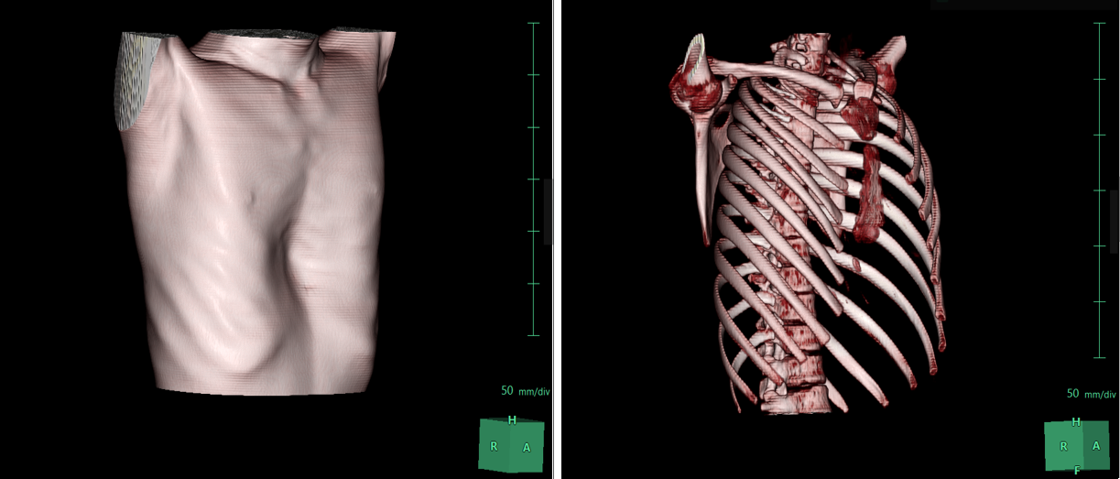
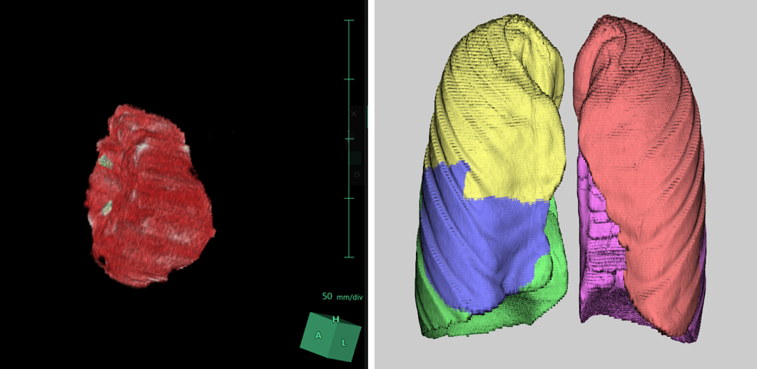
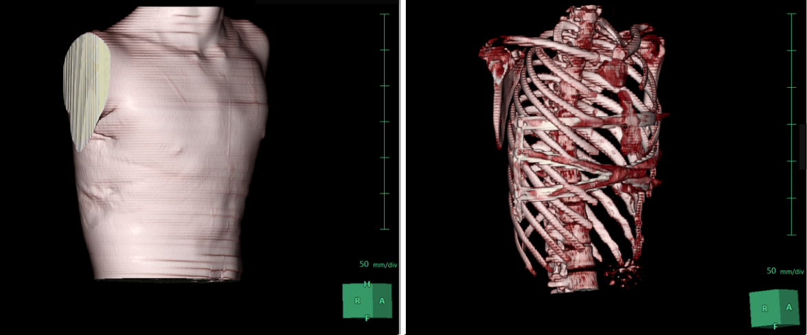
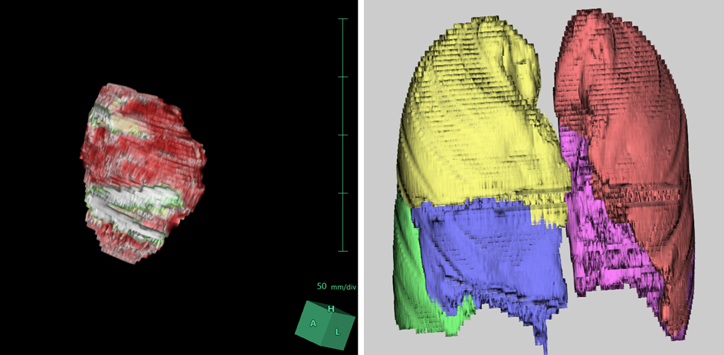
Results
Pre
Heart
Lungs
Post
Fig. 1. Three-dimensional CT images
Fig. 2. 3D image analysis using SYNAPSE 3D

Slide 5
Results
 | XI repair (n=63) | p-value
Lung volume
Total
Pre (range) | 4371.31 (±129.42)
Post (range) | 4266.87 (±120.43)
Δ volume | -104.42 (±23.77) | 0.52
Left
Pre (range) | 2052.51 (±62.01)
Post (range) | 2022.61 (±59.46)
Δ volume | -29.90 (±16.75) | 0.64
Right
Pre (range) | 2318.77 (±69.34)
Post (range) | 2310.86 (±63.01)
Δ volume | -7.90 (±16.27) | 0.70
Heart volume
Pre | 458.25 (±10.22)
Post | 499.13 (±10.85)
Δ volume | 40.89 (±5.27) | 0.018
The mean age: 16.95 years (range: 11–37)
Male (52, 82.54%)
Morphology: symmetric 40 (64%); asymmetric 23 (36%)
Haller Index change: 1.65 (range: 0.53–4.3, p < 0.01)
Depression Index change: 0.85 (range: 0.3–2.23, p < 0.01).
Lung volumes did not change postoperatively in total, left, and right lungs.
Cardiac volume increased from 458.25 ml to 499.13 ml, with a mean increase of 40.89 ml (9%) (p = 0.018).
Table 1. Volumetric changes after PE repair
(Data expressed as mean ± standard error)

Slide 6
Conclusion
Our Crane-Powered Entire Chest Wall Remodeling technique effectively treats various PE deformities, with the XI bar configuration now being a key part of our approach.
This method proved it not only restores the chest wall's structure but also improves its function.
Also, it has been proven to increase cardiac volume by decompressing the heart through entire chest wall remodeling.
The lung volumes remained unchanged, possibly due to their large volume nature, the less compressive effect of the deformity, and the postoperative chest wall restriction.
We found three-dimensional volumetric measurements seem valuable to evaluate the successful chest wall restoration in PE repair, as they provide potentially more accurate volume change information compared to traditional single- or two-dimensional CT measurements.

