Slide 1
Concomitant Tricuspid Valve Surgery
for Moderate Tricuspid Regurgitation
during Left-sided Valve Surgery

Slide 2
PURPOSE
Moderate tricuspid regurgitation (TR) is frequently encountered in left-sided valve diseases.
Previous studies on surgical repair of moderate TR show conflicting results.
Data on large single-center observational cohorts including >1,000 patients with long-term follow-up remain crucial, yet scarce
Concomitant tricuspid valve (TV) surgery during left-sided valve procedures remain controversial.
Objective: To evaluate long-term outcomes of concomitant TV surgery for moderate TR in patients undergoing left-sided valve surgery in a high-volume center.

Slide 3
METHODS
Retrospective, single-center study
Patients
  1,325 patients with moderate TR undergoing left-sided valve surgery between 2000 and 2022
  With concomitant TV surgery = 831 (62.7%); No concomitant TV surgery = 494 (37.3%)
Outcomes: median follow up 9.9 years (IQR 5.8 – 17.5)
  Clinical: All-cause mortality, CHF (congestive heart failure), TV reoperation, and composite endpoints of all-cause mortality, CHF, and TV reoperation
Analysis
  Propensity score matching (397 pairs; n=794) for adjustment
  Cox proportional-hazards models to assess associations of TV surgery and all-cause mortality, CHF, TV reoperation, and composite endpoints
  Subgroup analyses predefined cohorts

Slide 4
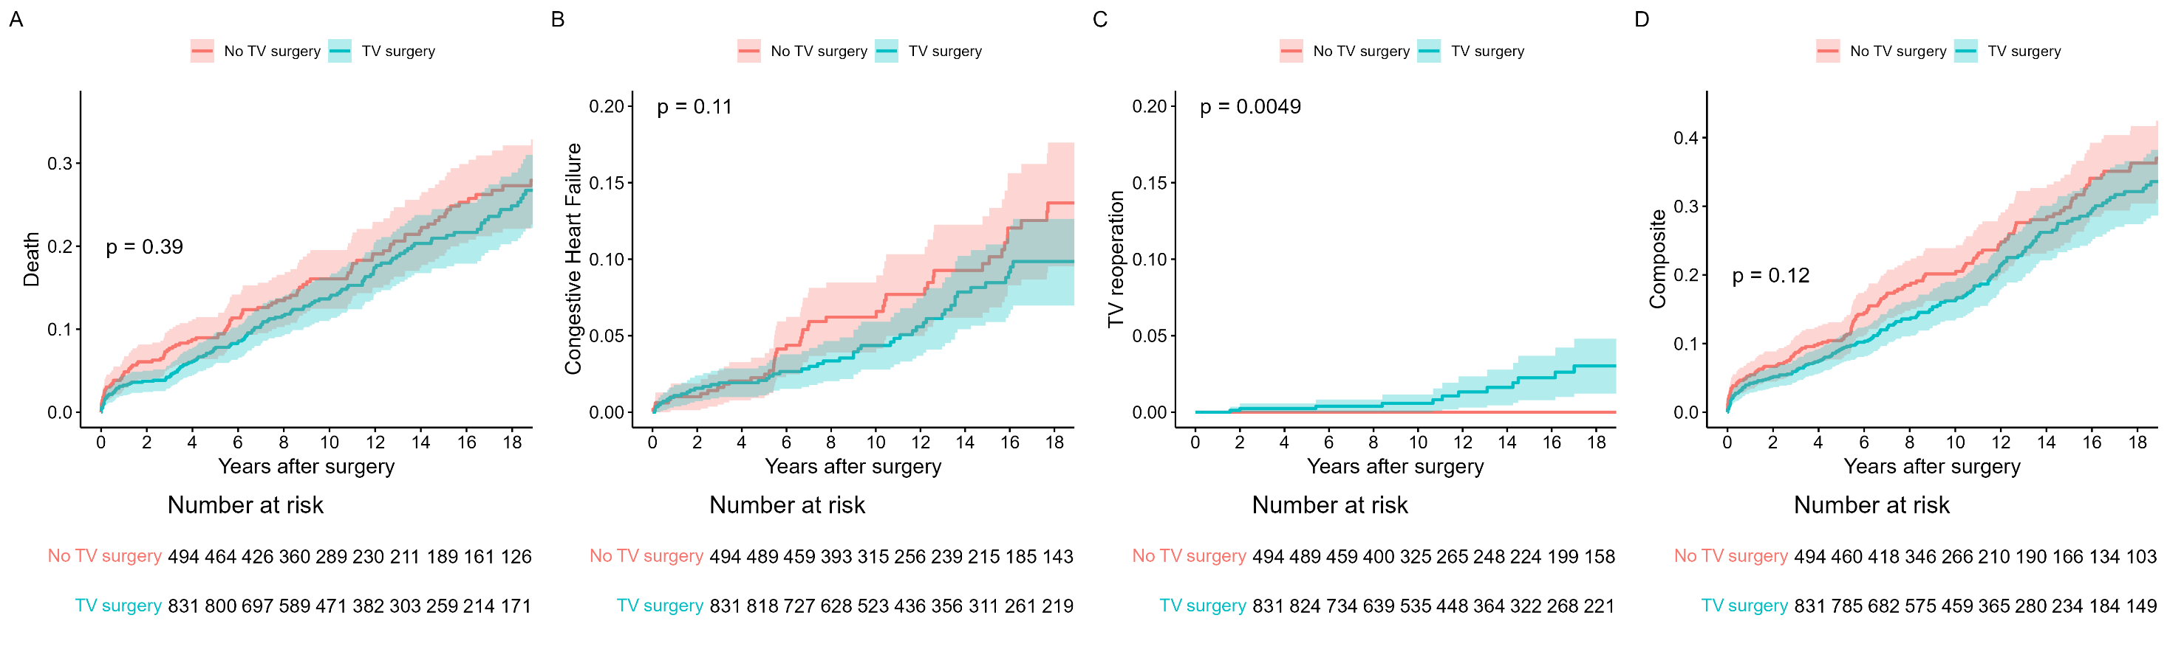
RESULTS
Propensity Score Matching – Adjusted Outcomes by Tricuspid Valve Surgery
Adjusted time-to-event analysis (Kaplan-Meier)
A
B
C
D
No TV surgery: reference
TV surgery: HR 0.95 (95% CI 0.69 – 1.31), p = 0.740
No TV surgery: reference
TV surgery: HR 0.59 (95% CI 0.35 – 1.04), p = 0.066
No TV surgery: reference
TV surgery: HR 17.78 (95% CI 2.22 – 2299), p = 0.003
No TV surgery: reference
TV surgery: HR 0.84 (95% CI 0.62 – 1.12), p = 0.235
Concomitant TV surgery showed no association with survival, CHF, and composite events, but revealed significantly higher TV reoperation risk.

Slide 5
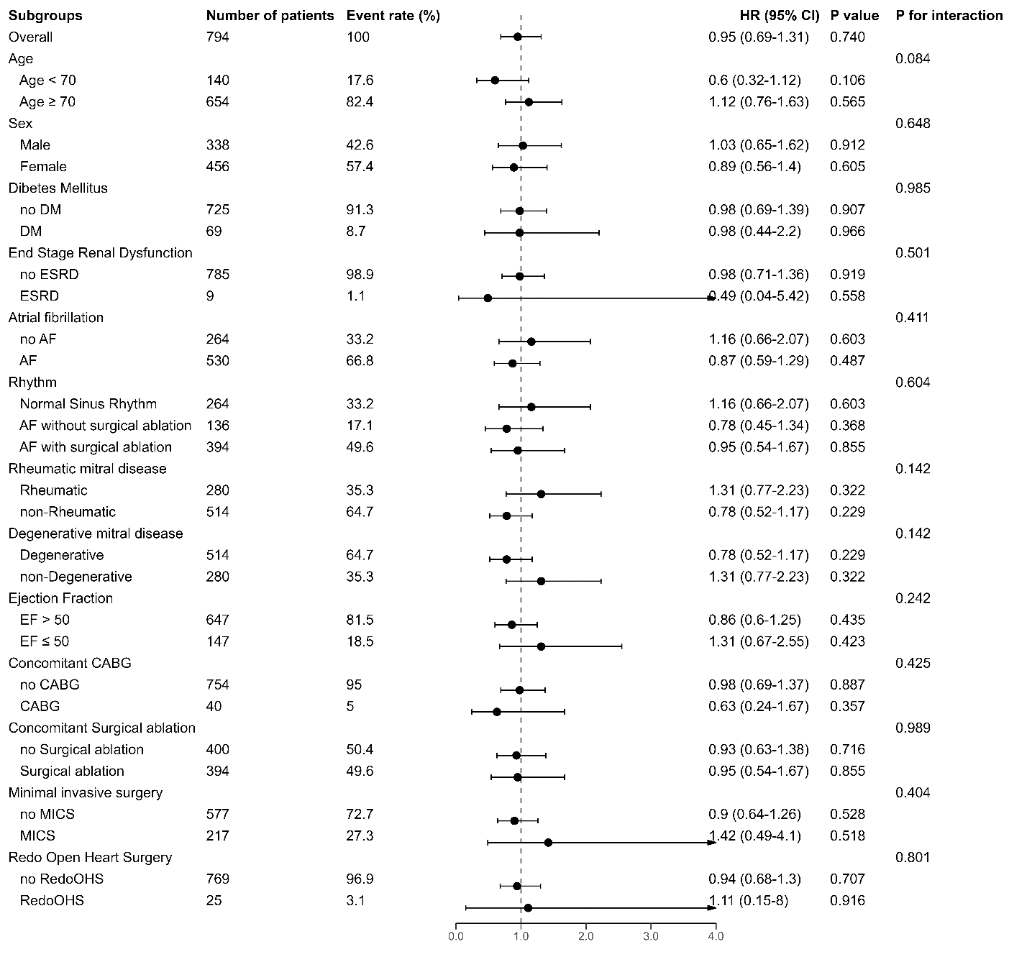
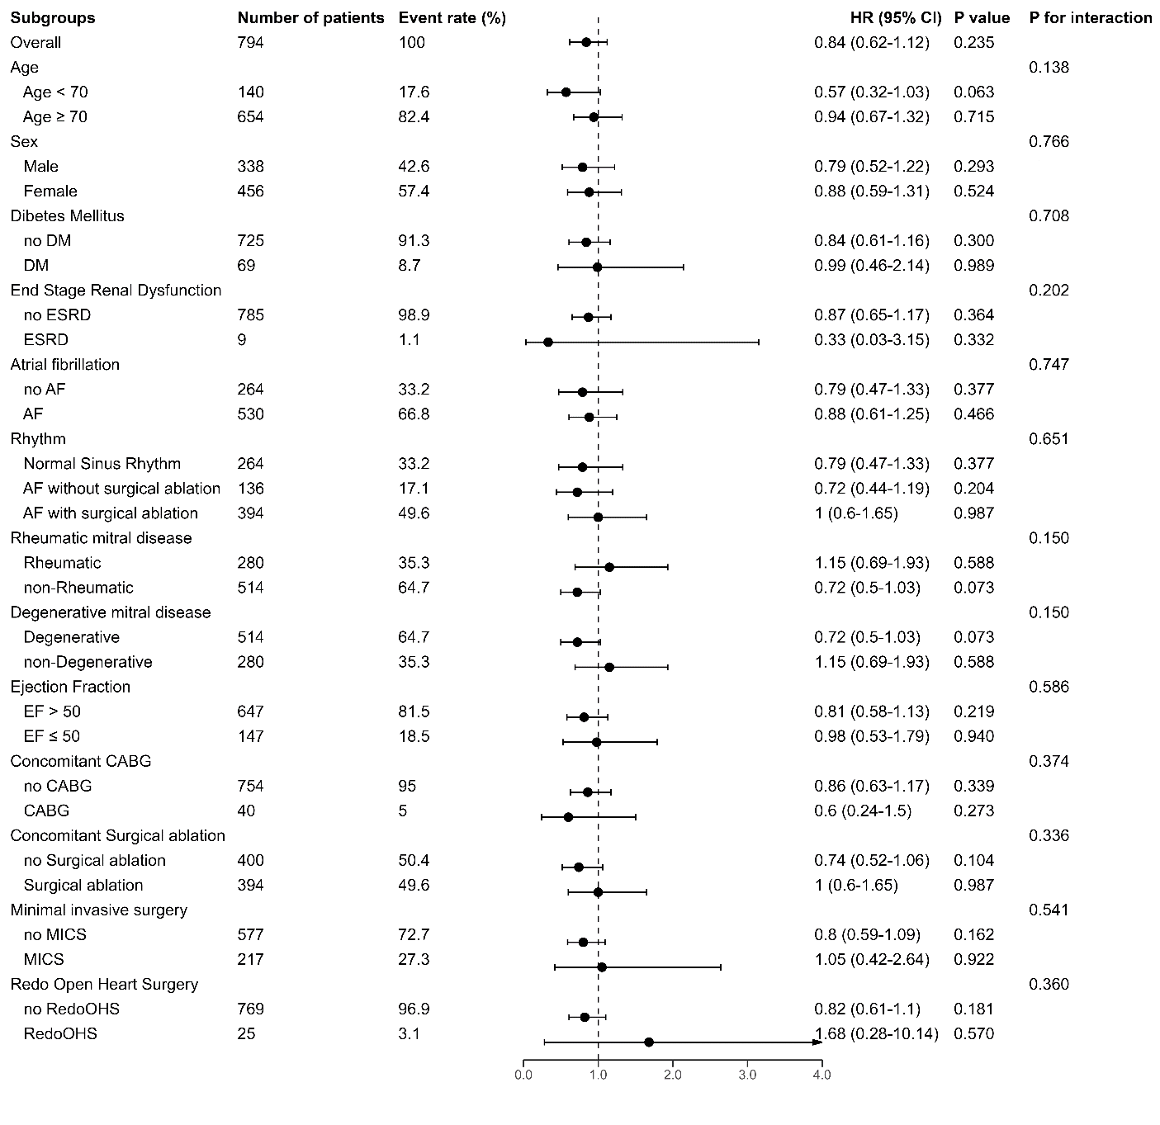
RESULTS
Propensity Score Matching – Adjusted Subgroup Analysis by TV Surgery
A
B
All-cause mortality
Composite outcomes
Subgroups showed consistent effects of concomitant TV surgery
with no significant interactions.

Slide 6
CONCLUSION
Concomitant TV surgery in moderate TR during left-sided valve procedures offered no survival or clinical benefit.
Instead TV surgery carried a higher risk of TV reoperation.
Routine surgical repair for moderate TR may expose patients to unnecessary risk without proven benefit.

