Slide 1
Acute Giant Bullae or Subpleural Pneumatocele
Resulting from Visceral Pleura Detachment:
A Mechanism Distinct from Bullae

Slide 2
Purpose
Pulmonary bullae are defined as “gas-containing cystic structures formed by confluent destroyed and dilated airspaces distal to the terminal bronchioles.” It usually develop slowly over time, often associated with underlying emphysematous changes.
Occasionally, a single giant bulla or vanishing lung syndrome can be found in patients with relatively healthy lungs rather than emphysematous lungs. However, the exact pathogenesis of giant bullae remains unclear.
Here, we report three surgical cases of sudden giant bullae or subpleural pneumatocele formation caused by visceral pleura detachment, a mechanism distinct from the conventional pathogenesis of bullae.

Slide 3
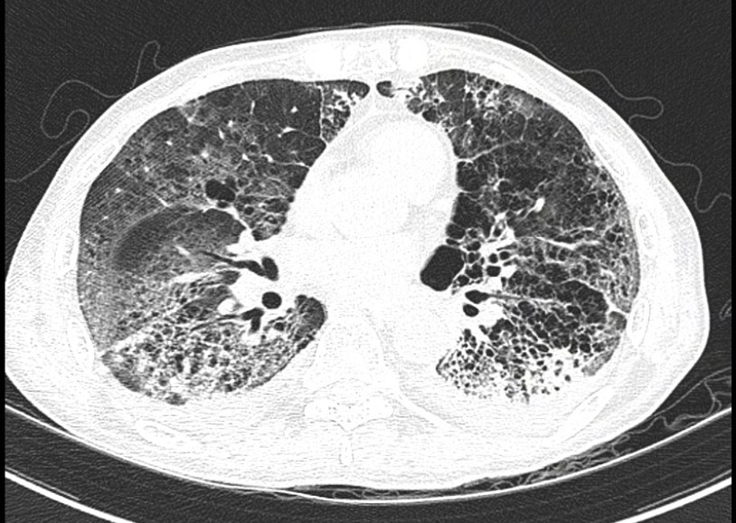
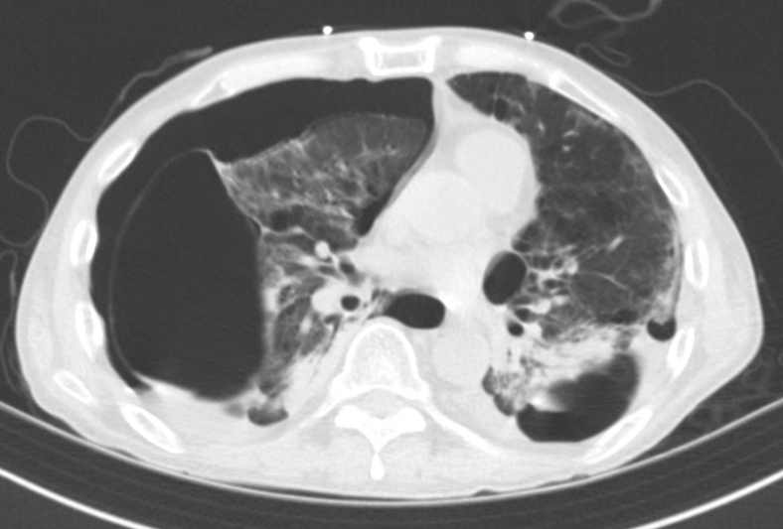
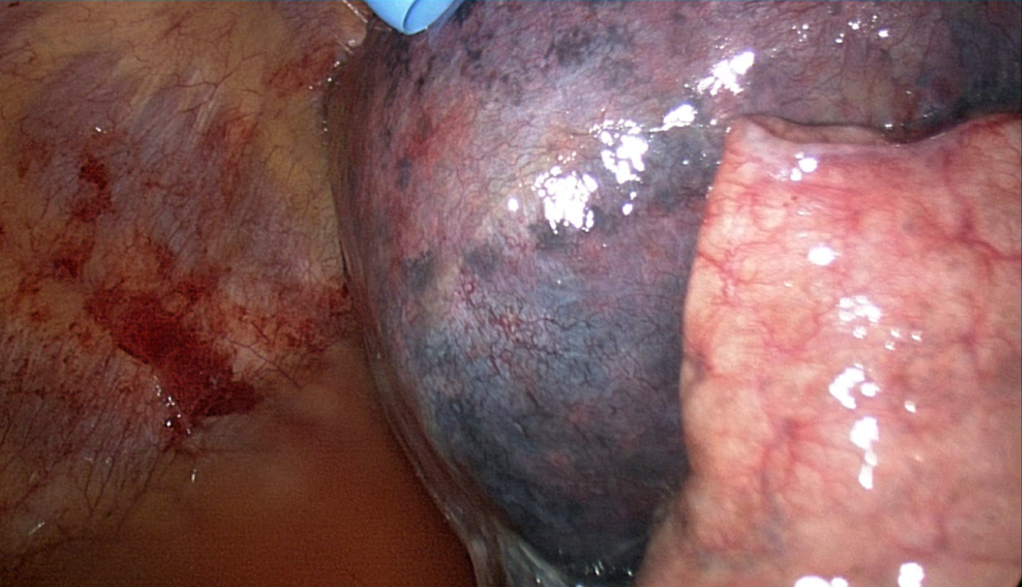
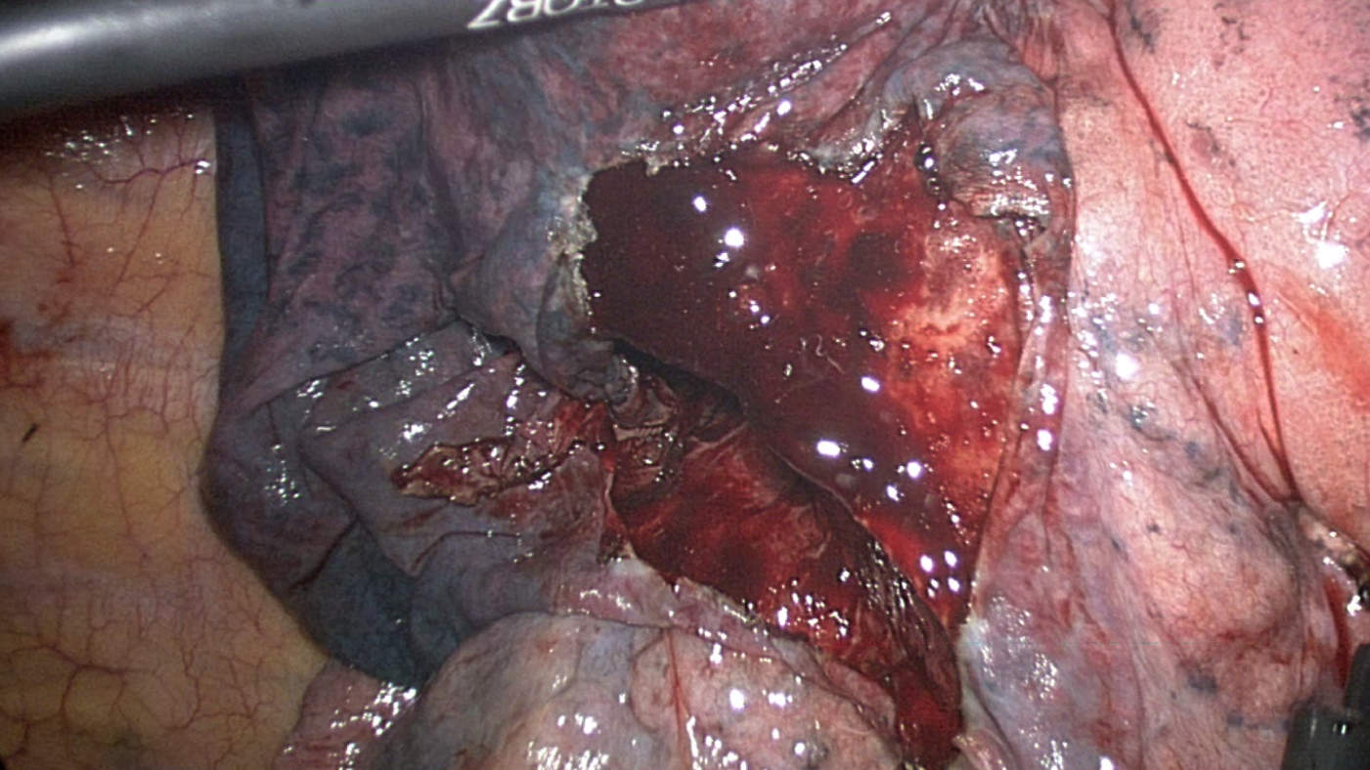
Case 1.
A 62-year-old male patient had COVID-19 pneumonia.
During the hospital course, chest radiography suddenly revealed a right pneumothorax with the development of pneumatocele, which had not been detected on the previous chest CT scan.
The patient underwent VATS exploration for a persistent air leak.
a
b
c
d
*
Figure 1.
Initial chest CT showed multifocal pneumonic consolidation (a).
On hospital day 45, the patient developed a right pneumothorax with a right lower lobe (RLL) pneumatocele (b, arrow).
Intraoperatively, the visceral pleura of the RLL was found to be detached from the lung parenchyma (c, arrow).
The cyst was opened and contained a blood clot, likely due to bleeding from the acute detachment. An asterisk (*) indicates the raw surface of the lung parenchyma (d).

Slide 4
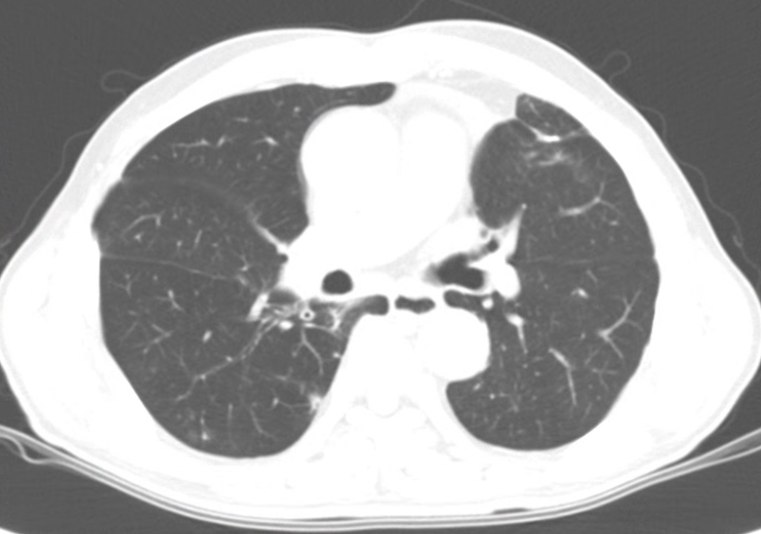
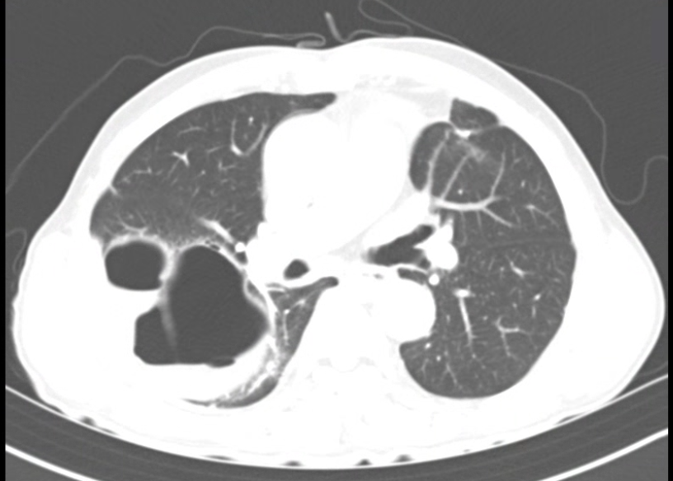
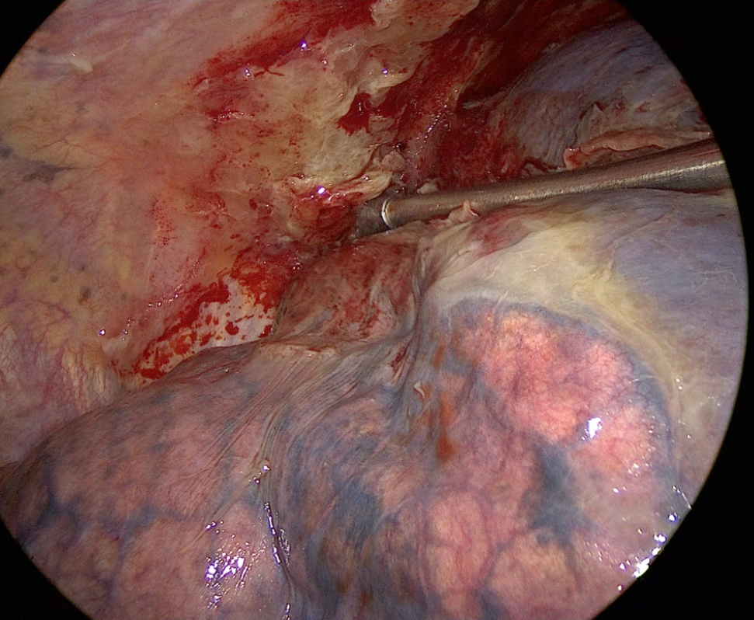
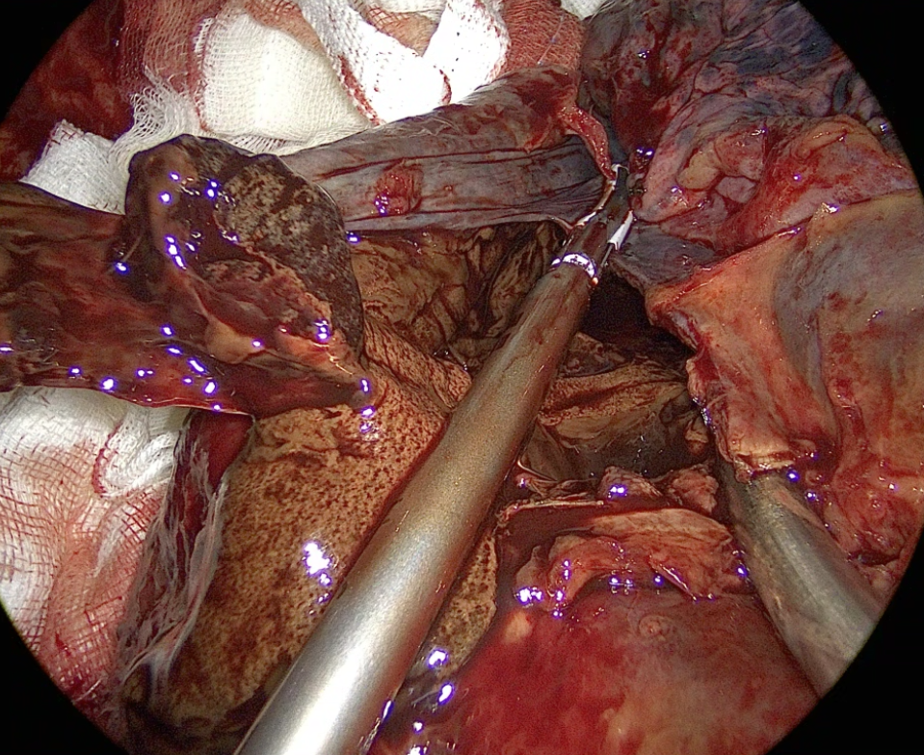
Case 2.
A 72-year-old male had previously undergone wedge resection of RUL and RLL for multiple primary lung cancers. During 18 months of postoperative follow-up, no significant events occurred.
However, the patient presented to the emergency room with hemoptysis. Chest CT revealed the sudden development of a fluid-containing air cyst, which had not been observed on the CT performed one month earlier.
On hospital day 12, surgical exploration was performed due to suspected infection.
a
b
c
d
*
Figure 2.
Chest CT performed one month earlier showed no pneumatocele or air cyst (a).
At admission, chest CT revealed a newly developed fluid-containing air cyst in the RLL (b, arrow).
Intraoperatively, the visceral pleura of the RLL was found to be detached from the lung parenchyma (c).
The cyst contained a chocolate-colored hematoma (d, arrow). The raw surface of the lung parenchyma also showed a chocolate color due to surface bleeding (d, *).

Slide 5
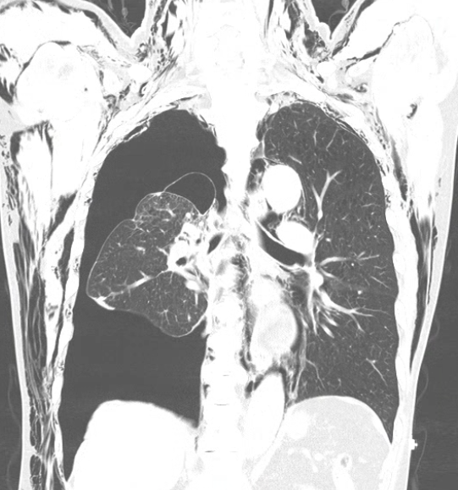
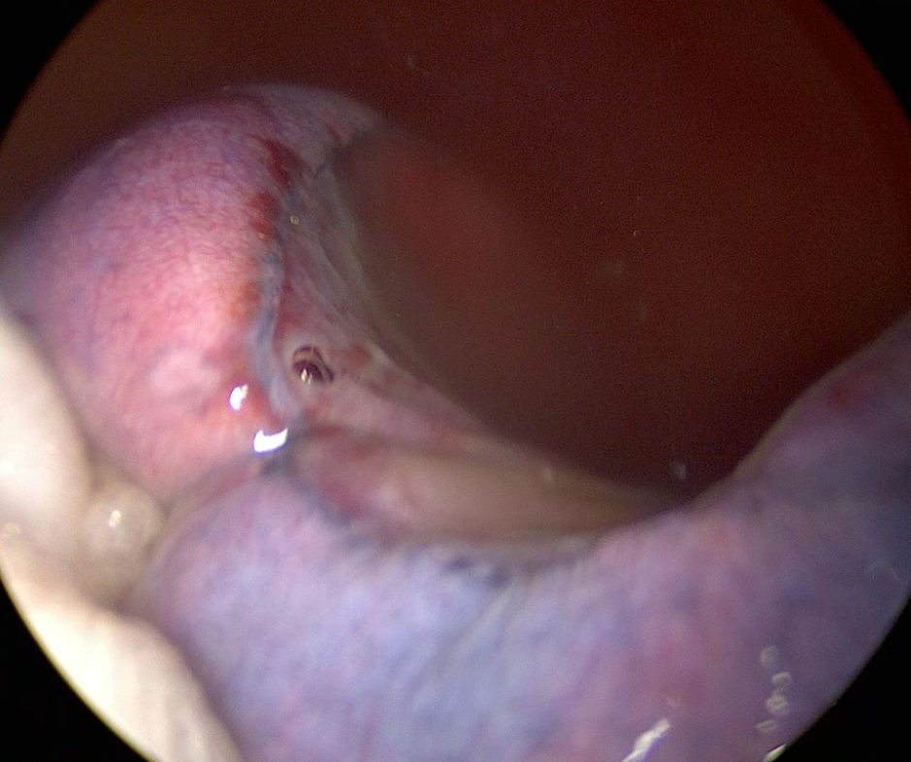
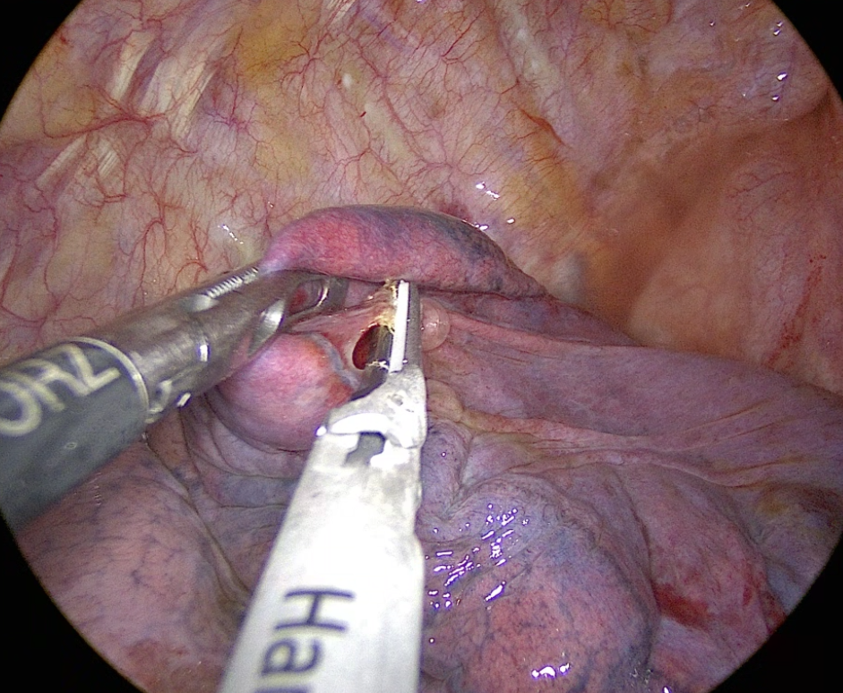
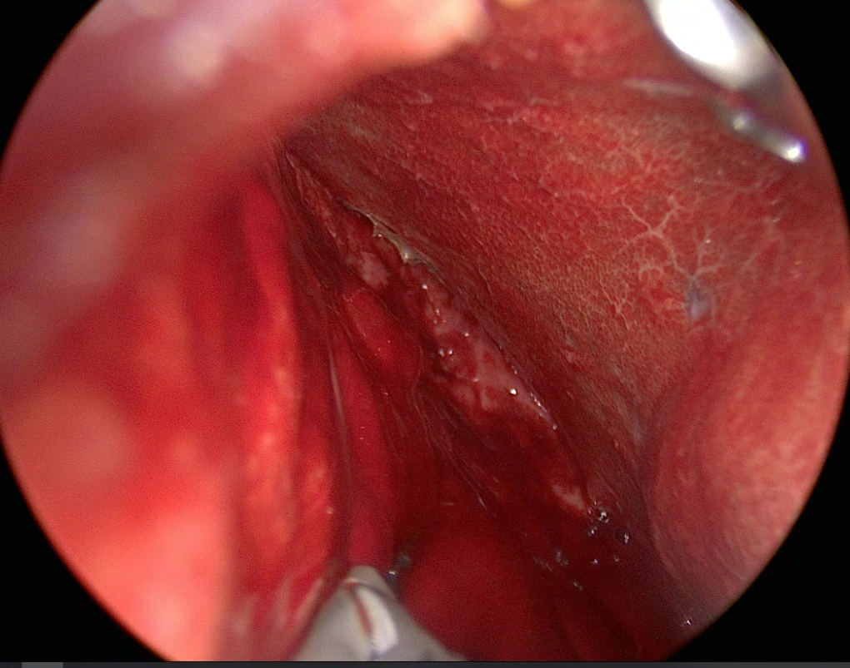
Case 3.
A 71-year-old male underwent RUL lobectomy for lung cancer and was discharged uneventfully on postoperative day 4.
However, ten days after discharge, the patient presented to the emergency room with dyspnea and subcutaneous emphysema. Chest CT revealed the sudden development of a large bulla in the RLL.
On the following day, VATS exploration was performed.
a
b
c
d
$
*
Figure 3.
Chest CT demonstrated a large bulla in the RLL (a, arrow). An air-leak point was identified in the RLL (b, arrow).
The detached visceral pleura was exposed (c). The visceral pleura ($) and the raw surface of the lung parenchyma (*) were sharply separated with minimal bleeding (d).

Slide 6
Conclusion
Acute detachment of the visceral pleura may represent another pathogenesis of giant bullae, large pneumatocele, or vanishing lung syndrome.
This mechanism could explain the occurrence of giant bullae or vanishing lung syndrome in patients without underlying emphysematous changes.
However, the exact cause of acute visceral pleura detachment requires further investigation.

