Slide 1
The relationship between cold ischemic time and graft failure in heart transplantation
:multicenter prospective study

Slide 2
Purpose
In heart transplantation (HT), a shorter cold ischemic time(IT) is generally recognized as a favorable prognostic factor, and longer cold ITs are associated with a higher incidence of graft dysfunction.
However, most studies have compared outcomes based on a certain threshold of cold IT (typically over 3 hours), and there is a lack of research analyzing outcomes across different ranges of cold IT.
In fact, a large-volume study based on the UNOS database reported that an extremely short cold IT of less than one hour was a strong risk factor for graft dysfunction.
The relationship between prolonged cold IT and the occurrence of graft dysfunction may differ from commonly accepted knowledge, but research on this topic is still limited.
Through a prospective data analysis conducted across multiple centers, we performed this study to investigate the clinical impact of different ranges of cold IT on outcomes in HT.

Slide 3
Methods
Figure 1. Subjects
Multi-center prospective registry
Adult (recipient`s age >18 y) isolated HT
Patients were divided into groups based on Cold IT
Primary endpoint: graft failure and death
Definition of graft failure: early postoperative ECMO apply (during ICU management)
Total Heart transplantation
from January 2014 to February 2023
N=1059
Exclusion (n=70)
Multi-organ transplantation (n=38)
Missing data (n=32)
Isolated HT
n=989
Group 1:
Cold IT ≤ 60 min
n=168 (17.0%)
Group 2:
60 min < Cold IT ≤ 120 min
n=445 (45.0%)
Group 3:
120 min < Cold IT ≤ 180 min
n=170 (17.2%)
Group 4:
180 min < Cold IT
n=206 (20.8%)

Slide 4
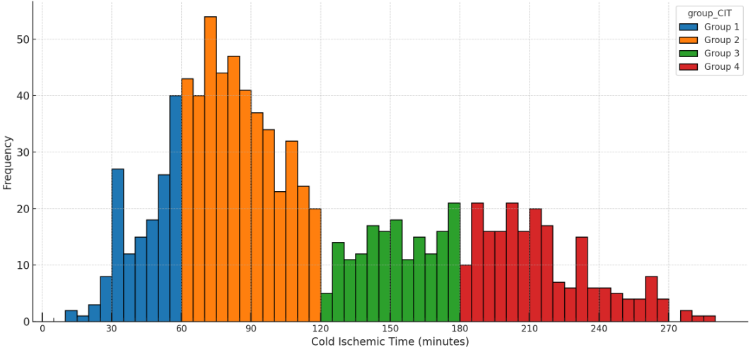
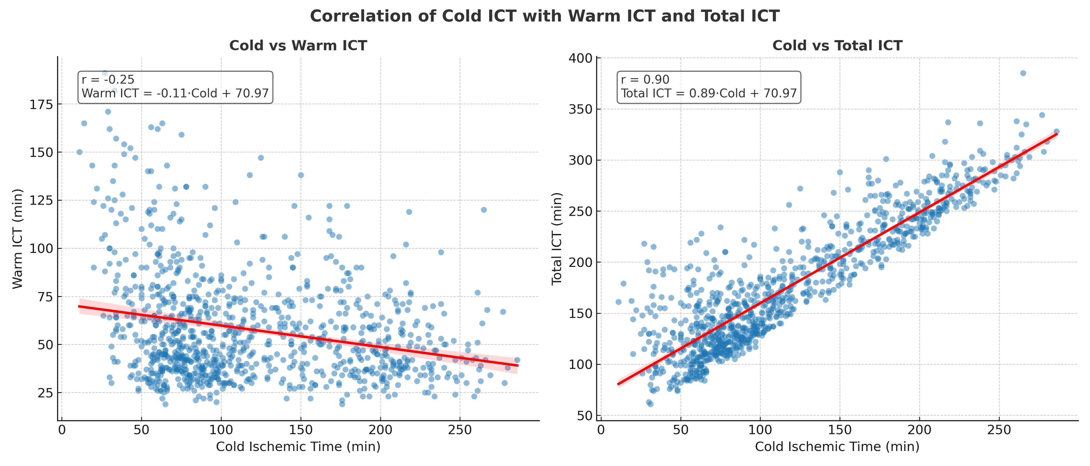
Results
Figure 2. Distribution of cold ischemic times
Table 1. Baseline characteristics
Variable | Group 1 (N=168) | Group 2 (N=445) | Group 3 (N=170) | Group 4 (N=206) | P-value
Recipient profiles
Sex (male) | 131 (78.0%) | 304 (68.3%) | 123 (72.4%) | 146 (70.9%) | 0.128
Age, years | 52.8 ± 13.1 | 54.1 ± 12.1 | 53.6 ± 12.5 | 53.8 ± 13.2 | 0.718
BMI | 22.4 ± 3.5 | 22.9 ± 3.6 | 22.7 ± 3.9 | 23.1 ± 6.7 | 0.402
Diabetes mellitus | 43 (25.6%) | 161 (36.2%) | 59 (34.7%) | 67 (32.5%) | 0.096
Preoperative hemodialysis | 30 (17.9%) | 83 (18.7%) | 19 (11.2%) | 44 (21.4%) | 0.069
Preoperative mechanical ventilator | 42 (25.0%) | 118 (26.5%) | 36 (21.2%) | 47 (22.8%) | 0.508
Preoperative ECMO support | 52 (31.0%) | 163 (36.6%) | 57 (33.5%) | 75 (36.4%) | 0.559
LVAD bridged transplantation | 3 (1.8%) | 29 (6.5%) | 8 (4.7%) | 14 (6.8%) | 0.342
Prior cardiac surgery | 4 ( 2.4%) | 23 ( 5.2%) | 5 ( 2.9%) | 10 ( 4.9%) | 0.352
Dilated cardiomyopathy | 86 (51.2%) | 213 (47.9%) | 78 (45.9%) | 100 (48.5%) | 0.434
Donor profiles
Sex (male) | 122 (72.6%) | 313 (70.3%) | 121 (71.2%) | 148 (71.8%) | 0.947
Age, years | 43.0 ± 11.2 | 40.9 ± 11.5 | 39.0 ± 12.4 | 39.8 ± 11.5 | 0.010
BMI | 23.8 ± 3.7 | 23.7 ± 3.7 | 23.5 ± 3.3 | 23.5 ± 3.4 | 0.835
Any inotropic agent | 151 (89.9%) | 388 (87.2%) | 154 (90.6%) | 181 (87.9%) | 0.606
Diabetes mellitus | 11 (6.5%) | 25 (5.6%) | 10 (5.9%) | 14 (6.8%) | 0.934
Figure 3. Correlation of cold IT with warm ICT and total IT
Table 2. Postoperative outcomes
Variable | Group 1 (N=168) | Group 2 (N=445) | Group 3 (N=170) | Group 4 (N=206) | P-value
Cold ischemic times, min | 45.8 ± 11.8 | 85.9 ± 16.6 | 152.9 ± 17.1 | 215.0 ± 24.3 | < 0.001
Total ischemic times, min | 122.5 ± 35.9 | 140.7 ± 28.0 | 212.5 ± 30.4 | 262.9 ± 29.6 | < 0.001
Bleeding reoperation | 17 (10.1%) | 39 (8.8%) | 10 (5.9%) | 13 (6.3%) | 0.359
Postoperative ECMO | 30 (17.9%) | 62 (13.9%) | 26 (15.3%) | 29 (14.1%) | 0.655
Early mortality | 9 (5.4%) | 20 (4.5%) | 6 (3.5%) | 12 (5.8%) | 0.732

Slide 5
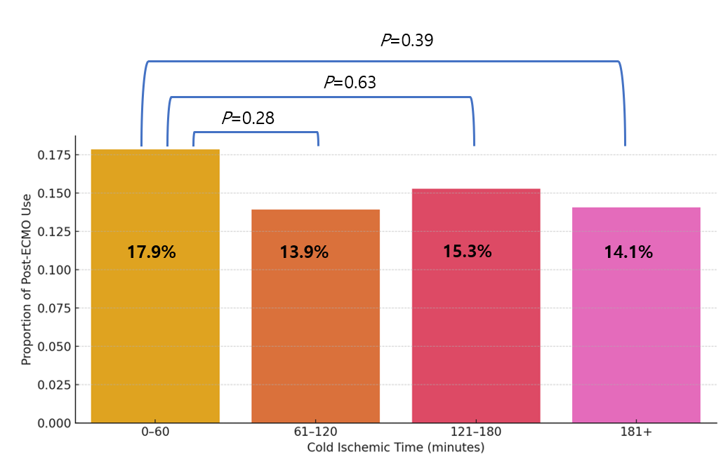
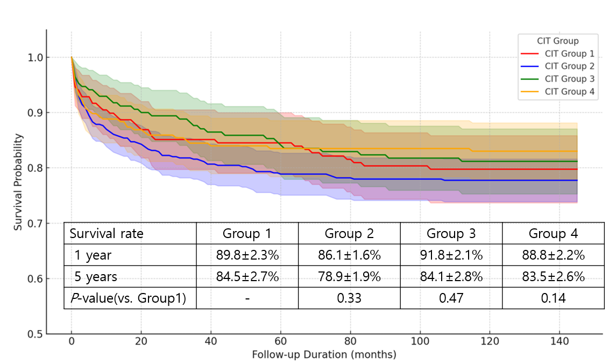
Results
Figure 4. Postoperative ECMO by cold IT
Table 3. Risk factor analysis for postoperative ECMO support
Variable | Univariate analysis |  |  | Multivariate analysis
 | Odd ratio | 95% CI | P | Odd ratio | 95% CI | P
Male | 1.41 | 0.93-2.13 | 0.100
Age | 1.00 | 0.99-1.02 | 0.786
DCMP vs. others | 0.52 | 0.36-0.75 | <0.001 | 0.66 | 0.45 – 0.98 | 0.038
DM | 1.32 | 0.92-1.90 | 0.133
Preoperative ECMO | 3.99 | 2.76-5.75 | <0.001 | 3.88 | 2.57 – 5.85 | <0.001
LVAD bridged HT | 1.28 | 0.65-2.52 | 0.474
Preoperative dialysis | 2.39 | 1.61-3.56 | <0.001 | 1.04 | 0.66 – 1.64 | 0.873
Preoperative CRP | 1.34 | 1.06-1.68 | 0.012 | 1.34 | 1.06 – 1.69 | 0.015
Cold IT | 1.00 | 0.99-1.00 | 0.902
Warm IT | 1.01 | 1.00-1.02 | 0.001 | 1.01 | 1.01 – 1.02 | <0.001
Age (donor) | 1.01 | 0.99-1.02 | 0.263
Male (donor) | 0.90 | 0.62-1.32 | 0.603
PHM <0.86 | 1.54 | 0.89-2.67 | 0.125
Figure 5. Survival curves by cold IT

Slide 6
Conclusion
In our study, approximately 80% of patients had a cold IT of less than 3 hours, and HT with a cold IT of less than 1 hour was performed in 17% of cases.
As cold IT increased, the total ischemic time in each group significantly increased; however, there were no differences in hard endpoints such as postoperative ECMO use or early mortality.
In our cohort, no increase in early adverse outcomes or difference in long-term survival was observed with longer cold IT. According to the results from our registry, an increase in cold IT within a certain range appears to have little association with poor patient outcomes.
In this study, the independent risk factors for graft failure (early postoperative ECMO) were preoperative ECMO use, elevated CRP levels, and prolonged warm ICT, while a diagnosis of DCMP appeared to act as a protective factor.
However, since the circumstances surrounding HT vary greatly by country, it is difficult to generalize these results. Further research on this topic is likely needed in the future.

