Slide 1
Outcomes of conventional CABG
in stable patients with low ejection fraction: compared with preserved ejection fraction

Slide 2
Purpose
Reduced left ventricular ejection fraction is known to increase perioperative mortality after coronary artery bypass graft (CABG).
The STICH trial shows that CABG improves long-term survival in patients with low LVEF.
However, evidence specifically addressing the safety of conventional CABG in such patients remains limited.
This study aims to evaluate short‑ and long‑term outcomes of conventional CABG in stable low LVEF patients compared with those with preserved EF.

Slide 3
Methods
616 isolated on-pump CABG (including ASD, PFO closure, LAA resection) patients between July/2014 and Dec/2024
Group: Low LVEF (≤35%) vs Normal LVEF (≥50%)
  Stable patients only (excluded no shock, previous ECMO, emergency op, acute myocardial infarction)
Retrospective analysis using IPTW, Landmark Kaplan-Meier survival analysis
Primary endpoint: 30-day or in-hospital mortality
Secondary: Early MACCE, Early postop complications, Long-term survival

Slide 4
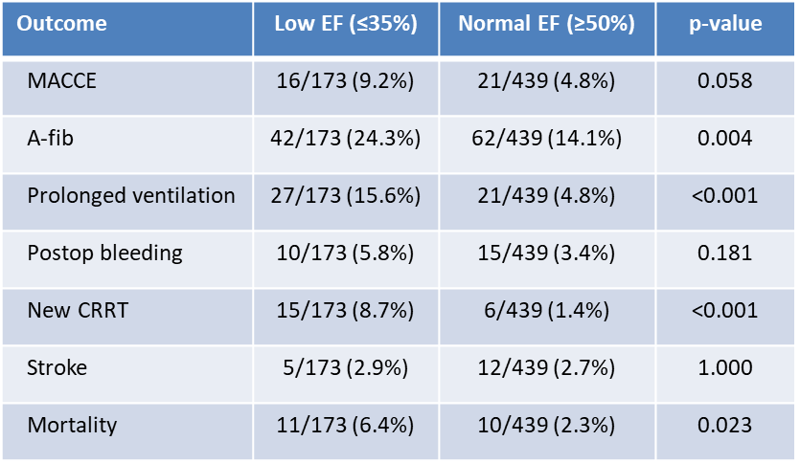
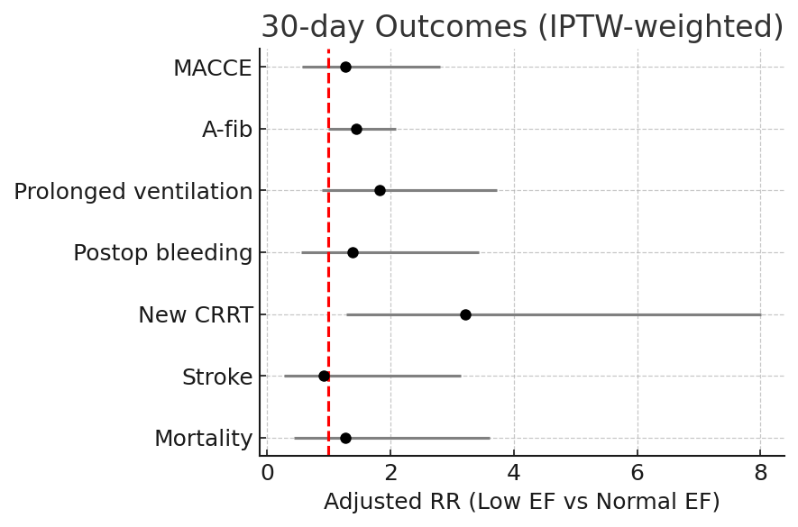
Results
Before IPTW
After IPTW
1.263 (0.057 - 2.812, p-value = 0.566)
1.443 (0.997 - 2.088, p-value = 0.052)
1.830 (0.897 - 3.731, p-value = 0.097)
1.382 (0.558 - 3.427, p-value = 0.485)
3.210 (1.288 - 8.001, p-value = 0.012)
0.924 (0.272 - 3.145, p-value = 0.900)
1.265 (0.442 - 3.613, p-value = 0.661)
Unadjusted analyses demonstrated worse outcomes in the low EF group; after IPTW adjustment, all outcomes were comparable except for new CRRT
Even after IPTW adjustment, new CRRT remained higher in the low EF group, likely reflecting intrinsic renal vulnerability and unmeasured perioperative factors
MACCE : Death + Stroke + Revascularization, In hospital or post op 30 day

Slide 5
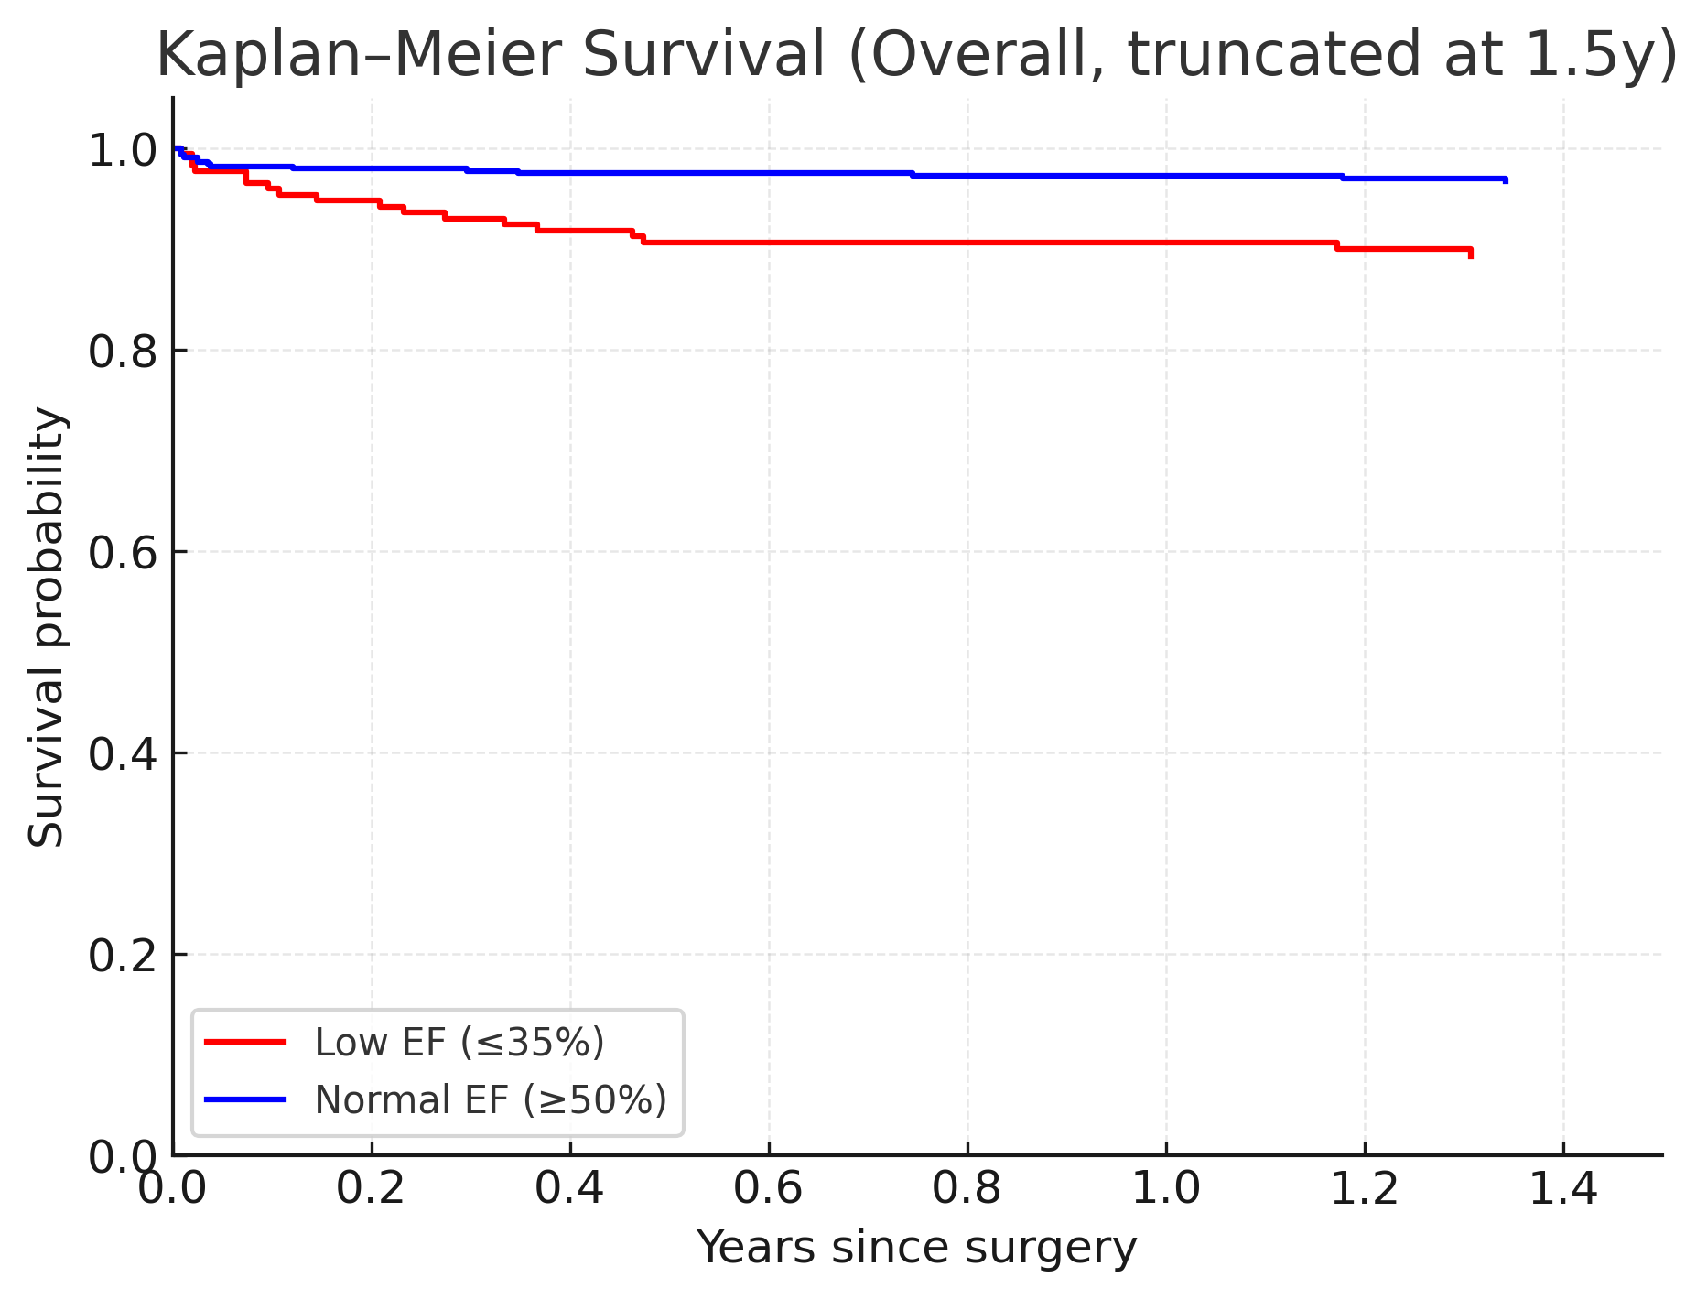
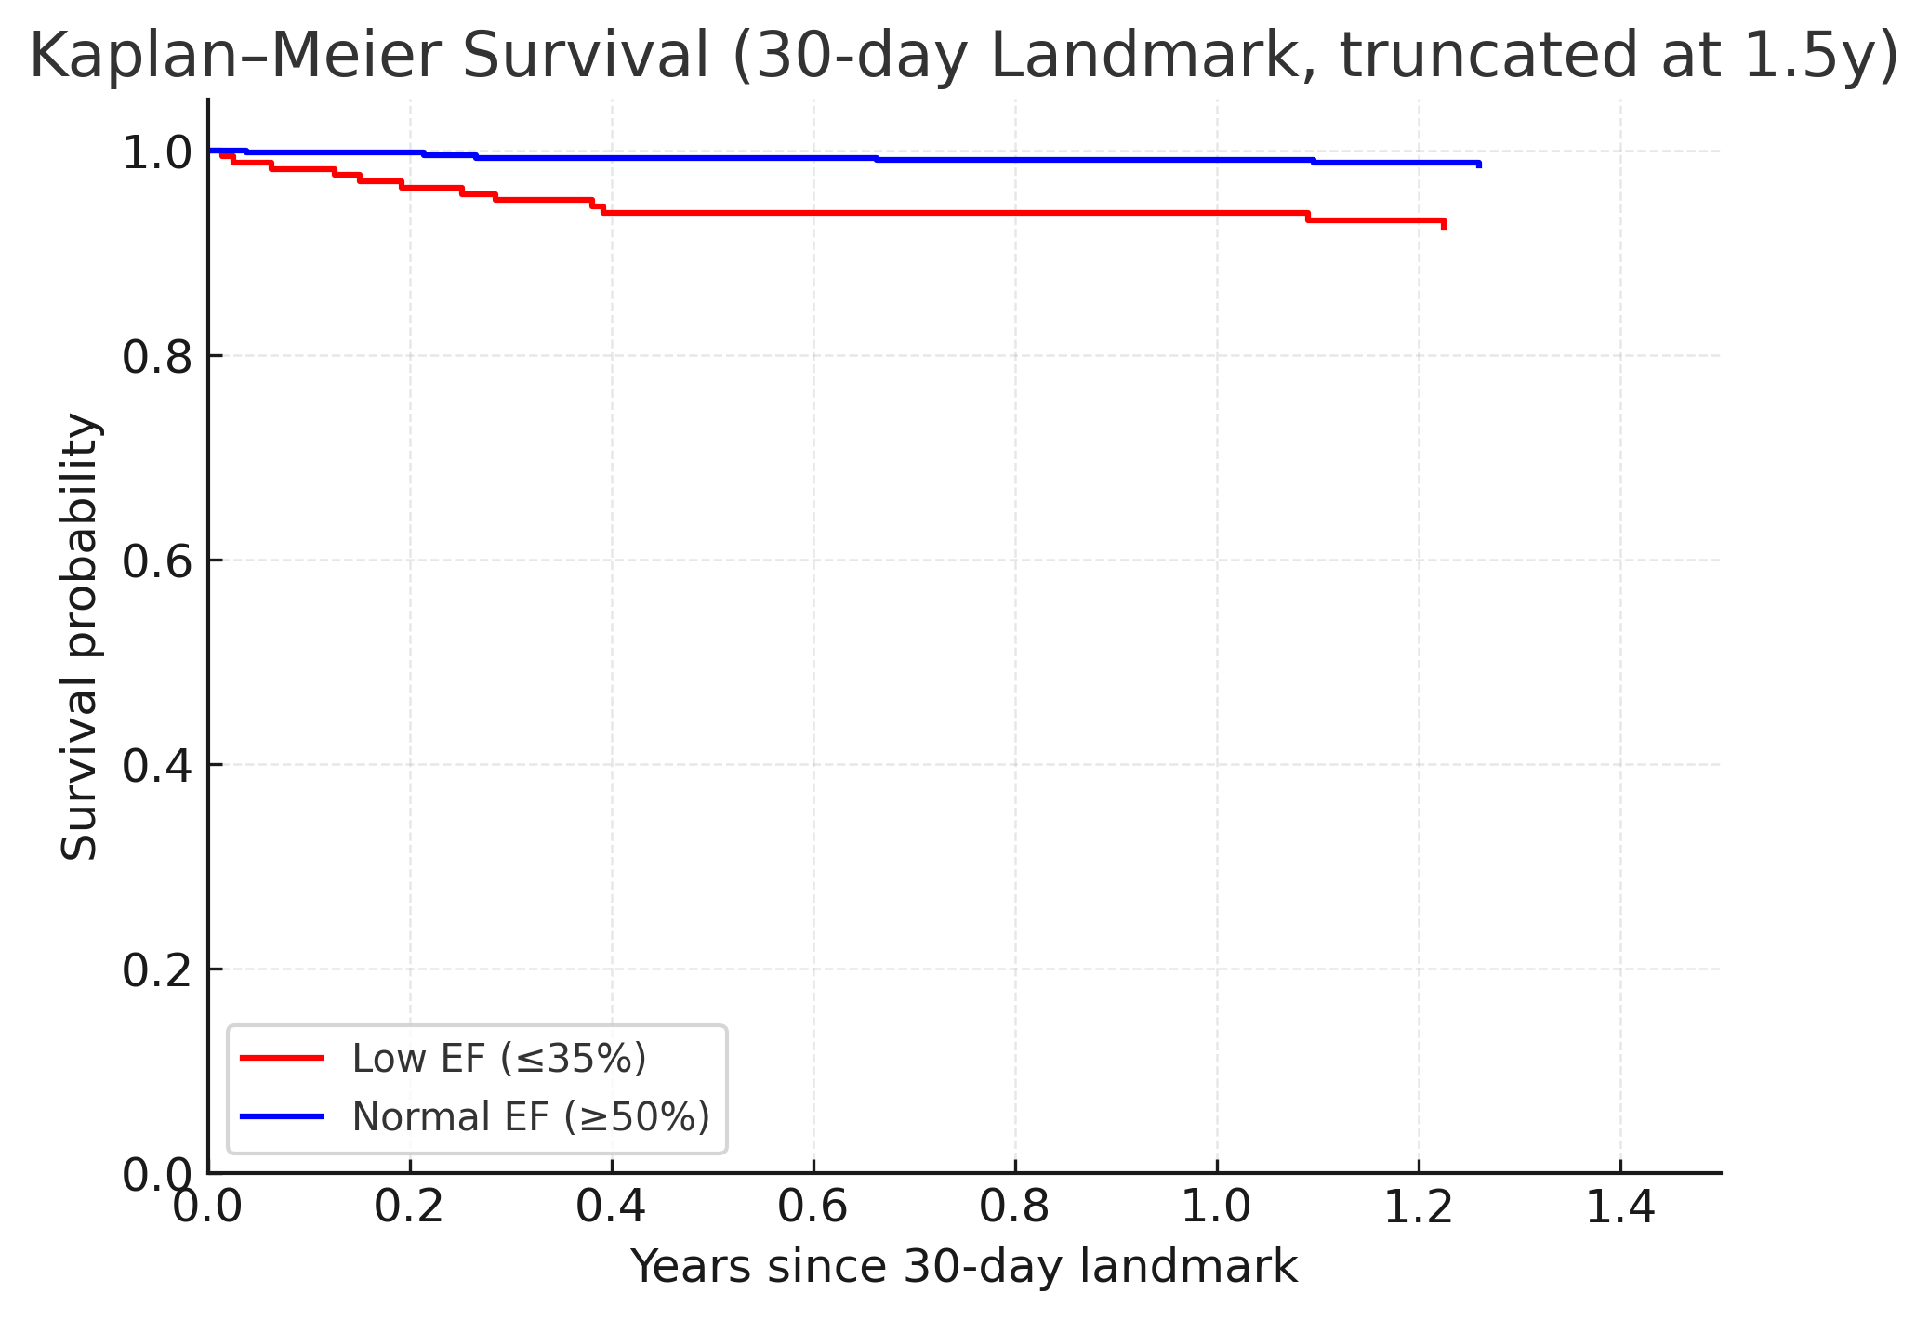
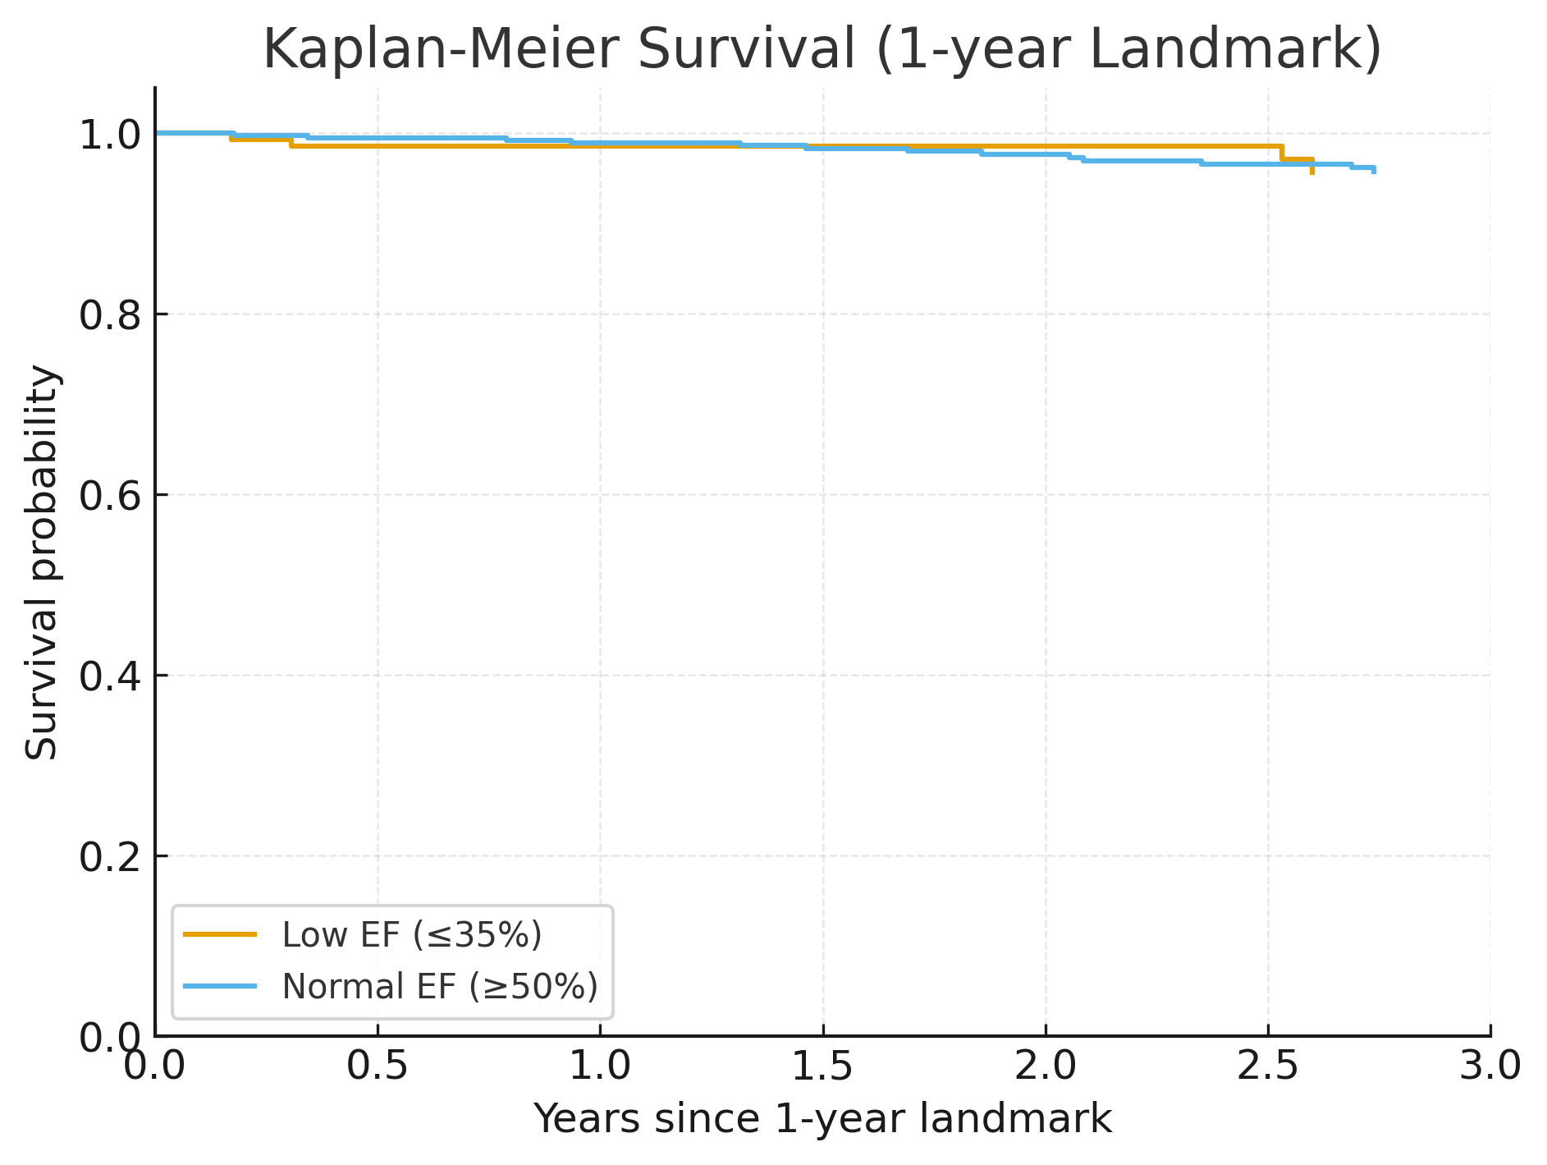
Results
Log-rank p = 0.018
Log-rank p = 0.045
Log-rank p = 1.000
Overall KM: Low LVEF group showed lower survival, reflecting both perioperative risk and baseline LV dysfunction.
30-day Landmark KM: After excluding early surgical mortality, the survival difference remained significant.
1-year Landmark KM: In stable survivors who lived beyond the first postoperative year, long-term survival was comparable irrespective of baseline EF..

Slide 6
Conclusion
In patients with stable low LVEF undergoing conventional CABG, short-term outcomes were comparable to those with preserved LVEF except requiring CRRT.
Although long-term survival remained inferior overall, this was attributable to underlying ventricular dysfunction rather than surgical risk.
Importantly, once patients survived the first year, their long-term survival became comparable to those with preserved LVEF.
Therefore, reduced LVEF alone should not be considered a contraindication to surgery.

