Slide 1
Surgical Management of A Huge Aortic Root Thrombosis in a Patient with LVAD Implantation

Slide 2
Introduction
Left ventricular assist device (LVAD) therapy is a life-saving treatment in end-stage heart failure.
Aortic root thrombosis is a rare but life-threatening complication in LVAD patients, particularly challenging due to high thrombus burden and complex hemodynamics.
This case is about a surgical management of aortic root thrombosis in a 73-year-old male patient who had previously undergone left ventricular assist device (LVAD, HeartMate 3) implantation for advanced heart failure.
Intraoperatively, a large (4x4 cm) acute thrombus was identified and removed from the aortic root, with restoration of coronary flow. Postoperatively, the patient required intensive care including VA ECMO and CRRT, but achieved complete thrombus removal and cardiac function recovery, resulting in successful discharge.
This case highlights the clinical features, diagnostic approach, and importance of surgical management for aortic root thrombosis, a rare but serious complication in LVAD recipients.

Slide 3
Objective
73-year-old male, Chief complaint for dizziness
NYHA IV, INTERMACS Level 4 (Resting Symptoms), Stage D HF
Ischemic CMP, STEMI (1VD), s/p PCI on pLAD (2018.08.21, other center)
s/p HM3 DT (2023.07.17) RAP 7, PAWP 11, CO index 2.21 (2023.08.07 RHC)
A-fib on anticoagulation
h/o sigmoid colon cancer s/p laparoscopic AR (2017.02.08, other center)
r/o TIA (2022.10) – no neurologic sequelae
The above patient was undergoing follow-up after undergoing LVAD (Heartmate 3) surgery at our hospital on July 17, 2023, due to ICMP.
Upon visiting the outpatient clinic of the Department of Cardiology, he complained of dizziness, sudden chest pain, cold sweats, and vomiting, and was admitted via the emergency room.
At the time of visit, NIBP was unmeasurable, HR was 30 beats/min.

Slide 4
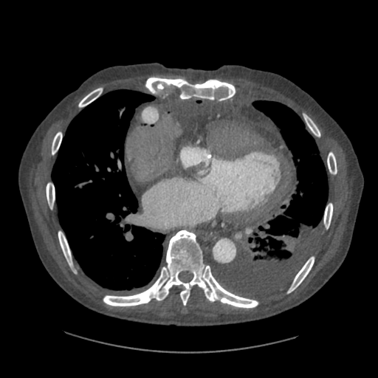
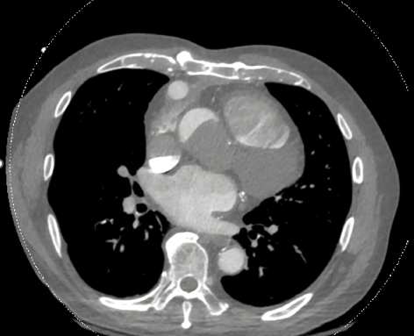
Computed tomography
２０２３－０８－０１
２０２５－０２－１８

Slide 5
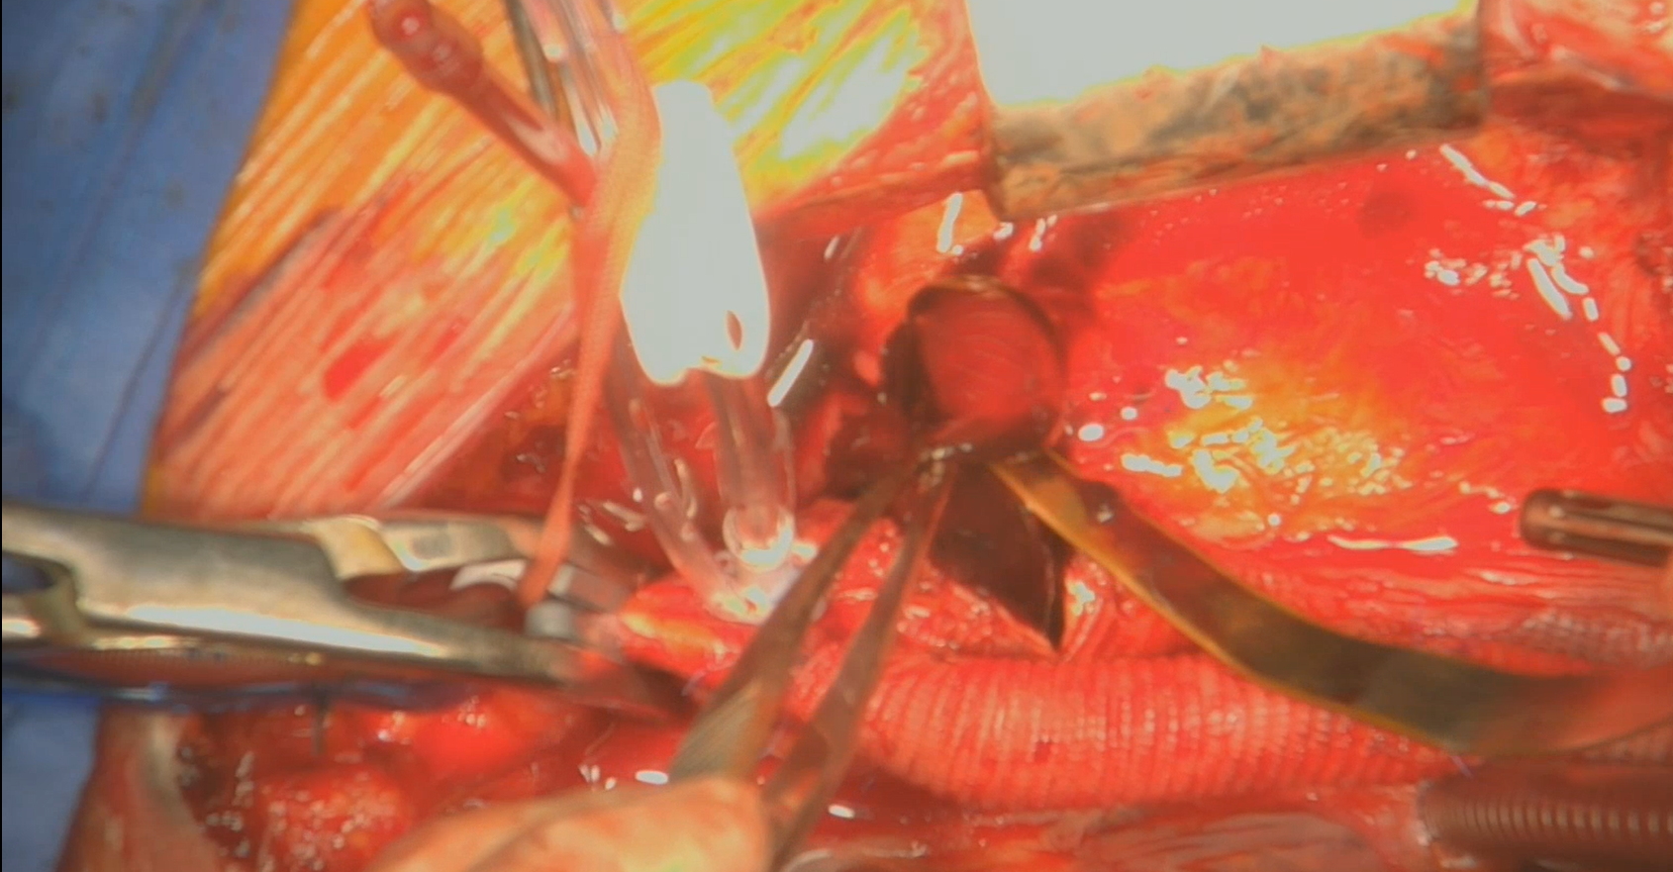
Redo sternotomy aortic root thrombectomy
OP Findings
: Severely adherent pericardium, non-beating heart, giant (4x4 cm) acute red thrombus at aortic root, bilateral coronary ostial obstruction.
Bypass Time – 49 min
ACC Time – 14 min
Postop course
: Thrombus completely removed (confirmed by CT, POD#21), gradual organ function recovery, discharged on POD#39.

Slide 6
Discussion
Aortic root thrombosis is uncommon on durable mechanical circulatory support.
Further discussion is needed regarding the treatment protocol for these patients with aortic root thrombus in LVAD patients.
Surgical thrombectomy without LVAD replacement in LVAD patients may be a treatment option.
There remains a question as to whether administering a cardioplegic solution might have helped the postoperative outcome.
References
  Guglin M, Rao RA. Aortic Thrombosis in Patients on Mechanical Circulatory Support: A Systematic Literature Review. Heart Lung Circ. 2023 Aug;32(8):926-937. doi: 10.1016/j.hlc.2023.04.295. Epub 2023 May 16. PMID: 37202310.
  Demirozu ZT, Frazier OH. Aortic valve noncoronary cusp thrombosis after implantation of a nonpulsatile, continuous-flow pump. Tex Heart Inst J. 2012;39(5):618-20. PMID: 23109752; PMCID: PMC3461675.
  Jahanyar J, Liao JM, DeValeria P, Steidley DE, Craner R, Ramakrishna H, Scott RL. Early Postoperative Aortic Root Thrombus After Heartmate 3. Heart Surg Forum. 2019 Sep 5;22(5):E372-E374. doi: 10.1532/hsf.2635. PMID: 31596714.
  Klotz S, Karluss A, Stock S, Frydrychowicz A, Sievers HH. HeartMate III Left Ventricular Assist Device Thrombosis Triggered by an Automatic Implantable Cardioverter-Defibrillator Shock. Ann Thorac Surg. 2017 Dec;104(6):e421-e424. doi: 10.1016/j.athoracsur.2017.08.006. PMID: 29153809.
  Bunge JJH, den Uil CA, Constantinescu AC, Budde RPJ, Maat APWM, Caliskan K. Acute Pump Thrombosis in the Early Postoperative Period After HeartMate 3 Implantation. ASAIO J. 2019 Sep/Oct;65(7):e72-e74. doi: 10.1097/MAT.0000000000000932. PMID: 30681438.
  Kakino T, Saku K, Nishikawa T, Sunagawa K. The Partial Support of the Left Ventricular Assist Device Shifts the Systemic Cardiac Output Curve Upward in Proportion to the Effective Left Ventricular Ejection Fraction in Pressure-Volume Loop. Front Cardiovasc Med. 2020 Sep 15;7:163. doi: 10.3389/fcvm.2020.00163. PMID: 33102535; PMCID: PMC7522370.
  Ilonze OJ, Torabi A, Guglin M, Saleem K, Rao R. Aortic root thrombosis leading to STEMI in a Heartmate 3 patient. J Artif Organs. 2023 Mar;26(1):73-78. doi: 10.1007/s10047-022-01339-y. Epub 2022 May 23. PMID: 35604615.

