Slide 1
On-Q® PainBuster® vs. IV PCA for Post-Thoracic Surgery Pain Management: A Prospective Randomized Study

Slide 2
Purpose
Thoracic surgery causes more severe postoperative pain than most other surgeries
Pain control critical for recovery & pneumonia prevention
  VATS: reduced pain due to smaller incision size
  TEA: Effective but complex and risky
  IV-PCA: Easy preparation but systemic side effects (nausea, dizziness)
On-Q Painbuster: Continuous local anesthetic delivery
  Lower rate of systemic side effects
  Effect proven in abdominal surgery but limited RCT in thoracic surgery
This study aims to prospectively compare On-Q Painbuster with IV-PCA in thoracic surgery patients to evaluate efficacy, side effects, and overall clinical utility.

Slide 3
Methods
Single tertiary center
Prospective randomized controlled study
Total 200 patients receiving lung resection using VATS: 100 On-Q vs. 100 IV-PCA
Collection of pain scores during resting and after exercise on scheduled intervals until discharge
Administration of rescue medications was performed according to a pre-established protocol based on pain scores and clinical symptoms.
Follow-up pain score survey during 1st and 2nd visit at outpatient department.

Slide 4
Results
Table 1. Basic Characteristics by pain control methods (Total N = 153)

Slide 5
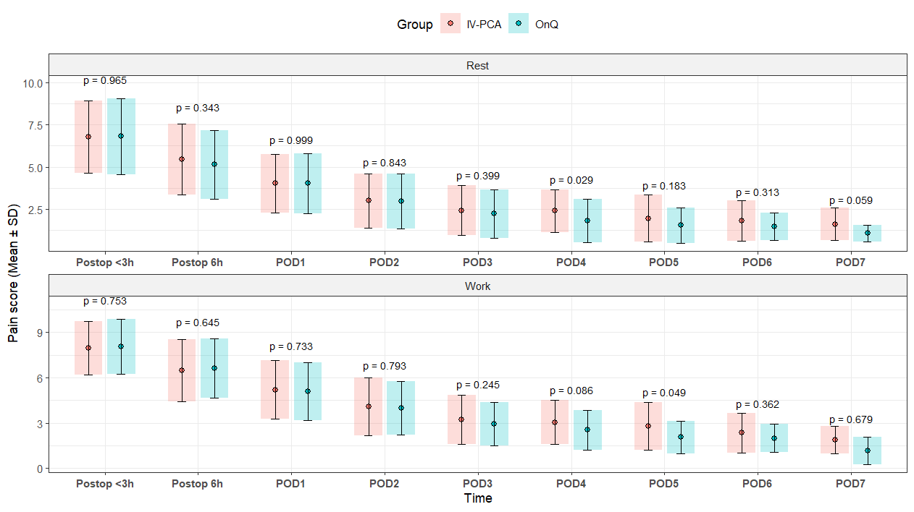
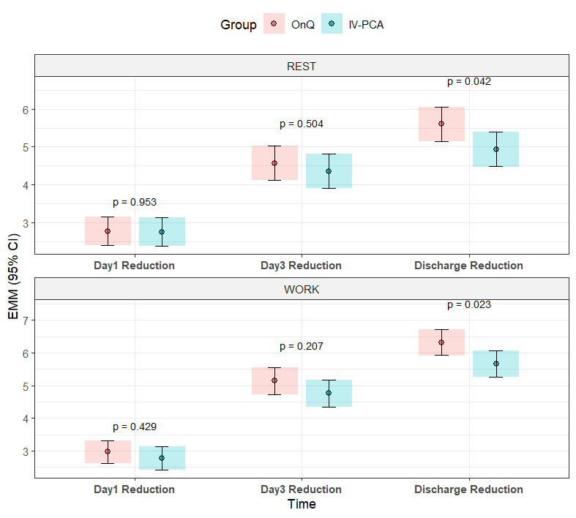
Results
Figure 1. Daily Pain score distribution by types of pain control methods.
Figure 2. Pain score difference

Slide 6
Conclusion
There was no significant difference in immediate postoperative pain scores between the On-Q and IV-PCA groups.
The reduction in pain scores until the time of discharge was significantly greater in the On-Q group.
The On-Q group demonstrated a significantly lower incidence of side effects such as nausea and vomiting, and required fewer additional doses of antiemetics compared with the IV-PCA group.
In the IV-PCA group, the administration of additional opioid rescue medications for pain control was significantly more frequent.
In summary, while immediate postoperative pain control was comparable between On-Q and IV-PCA, On-Q provided superior sustained analgesia during the postoperative course. This effect may be associated with previously reported mechanisms of increased pain threshold induced by continuous local anesthetic infusion.

