Slide 1
Influence of Biopsy Method on Recurrence Risk in Lung Cancer: A Comparative Analysis by Tumor Location and Morphology

Slide 2
Purpose
Lung cancer is the most common cancer and the leading cause of cancer mortality.
LDCT screening enables earlier detection and reduces mortality.
Increased detection has raised the use of biopsy and surgical resection in early disease.
PCNB is widely used, being safe, minimally invasive, and accurate.
However concerns remain about potential tumor dissemination.
Prior studies report conflicting results on recurrence risk after PCNB.
This study aimed to compare PCNB with surgical biopsy and assess their impact on recurrence-free survival by tumor characteristics.

Slide 3
Methods
Single tertiary center retrospective cohort study
Total 364 primary lung cancer patients who received lung resection
CT characteristics including C/T ratio and intralobar location of the tumor was obtained
Group comparison between intraoperative biopsy vs. PCNB
Recurrence by location, pleural metastasis, risk factors for recurrence by biopsy methods were compared

Slide 4
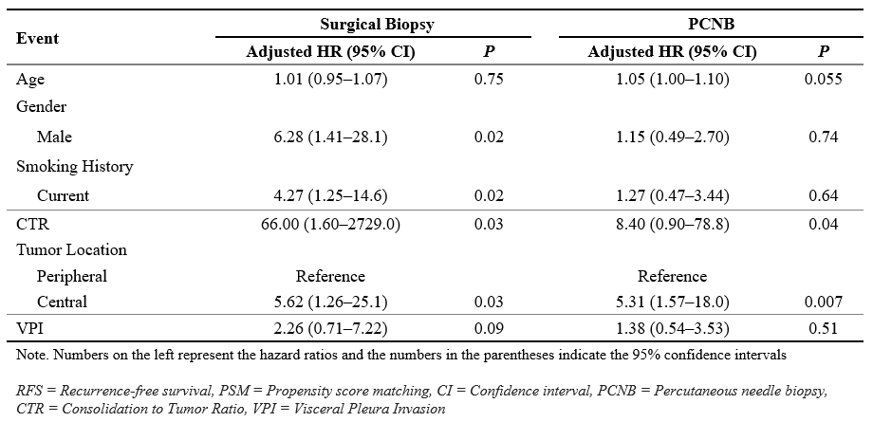
Results
Multivariate Cox Regression analysis of factors associated with RFS (pre/post PSM) | Impact of surgical biopsy and PCNB on recurrences (post PSM)

Slide 5
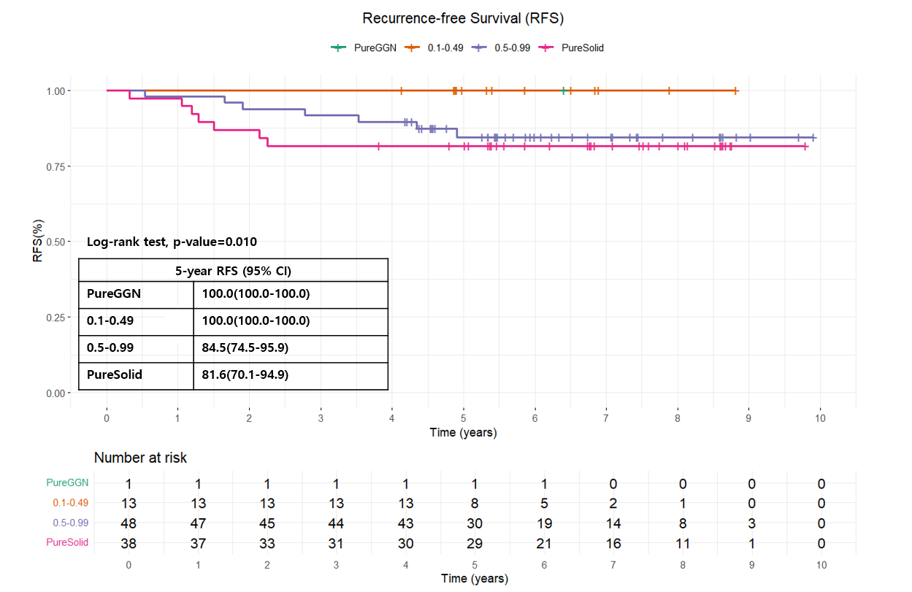
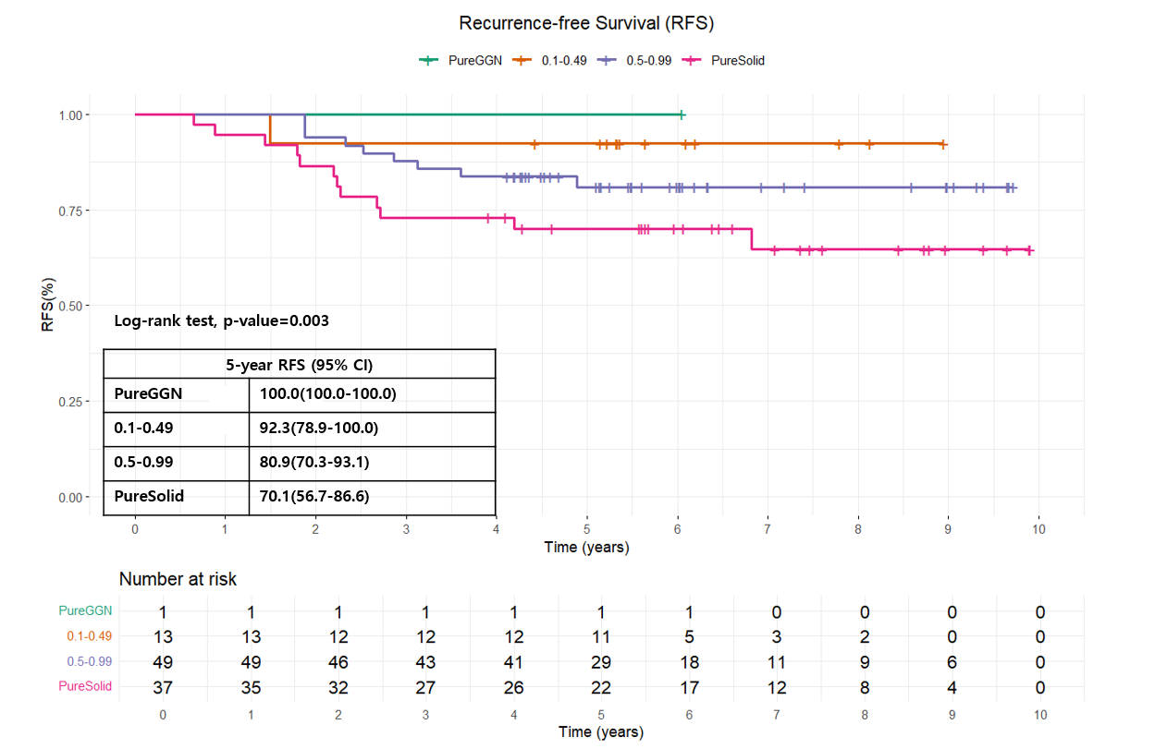
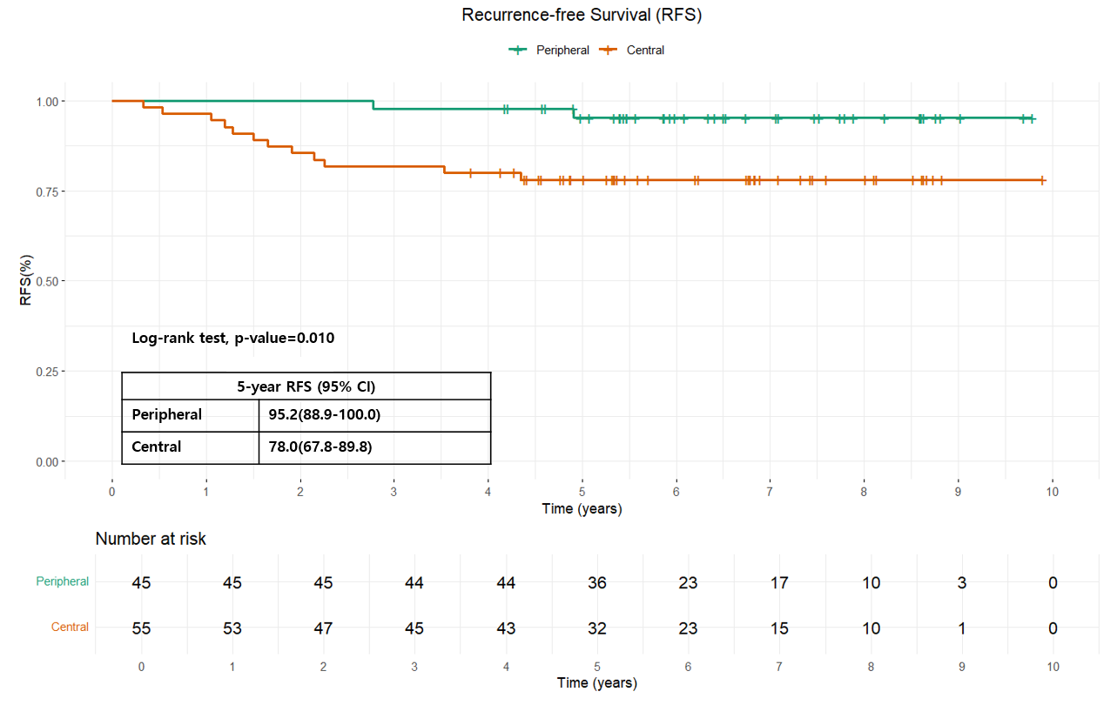
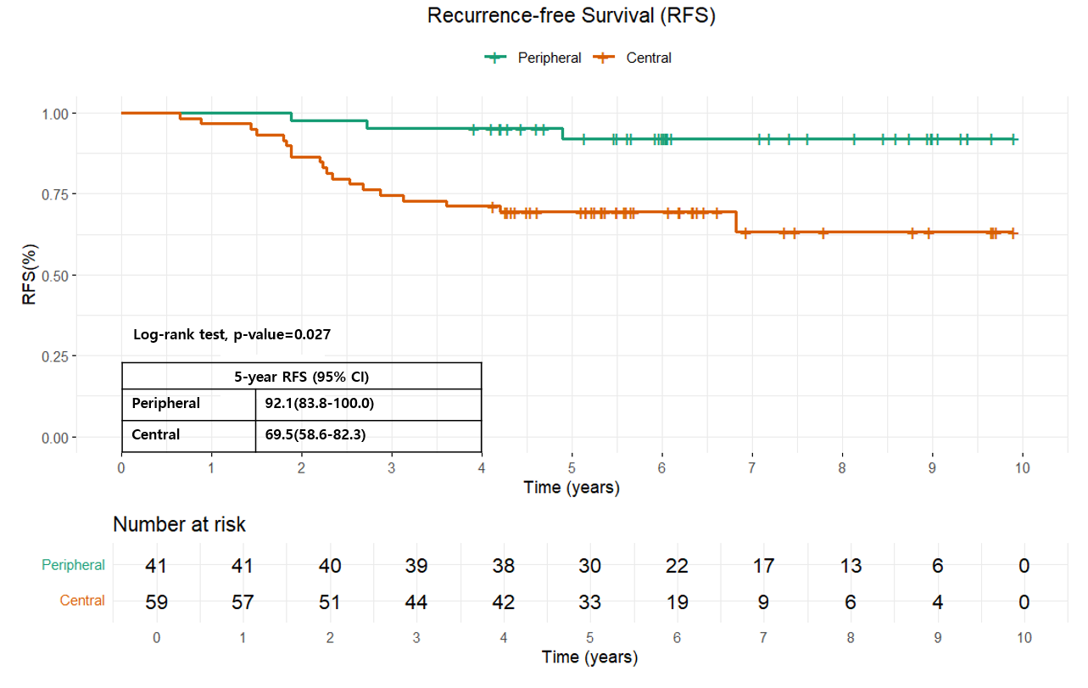
Results
Figure 1 (A) RFS by CTR group (Surgical biopsy), (B) RFS by CTR group (PCNB), (C) RFS by Tumor locations (Surgical biopsy), (D) RFS by Tumor location (PCNB)

Slide 6
Conclusion
PCNB itself was not an independent risk factor for recurrence after PSM.
Higher rates of locoregional and pleural recurrence were observed in the PCNB group, suggesting possible clinical relevance.
Centrally located and solid tumors require a more cautious diagnostic approach, where surgical biopsy or sub-lobar resection may be preferable.
These findings highlight the need for individualized biopsy strategies, and further multicenter prospective studies are warranted.

