Slide 1
Continuous Erector Spinae Plane Block Versus Thoracic Epidural Analgesia After Thoracotomy: A Randomized Controlled Assessor-Blinded Non-Inferiority Trial

Slide 2
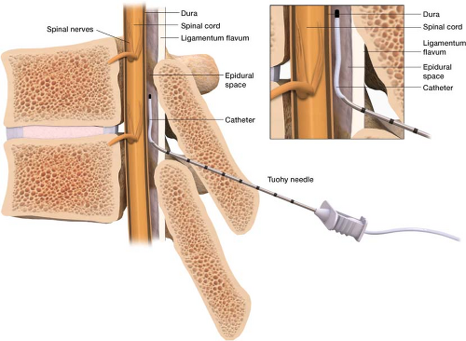
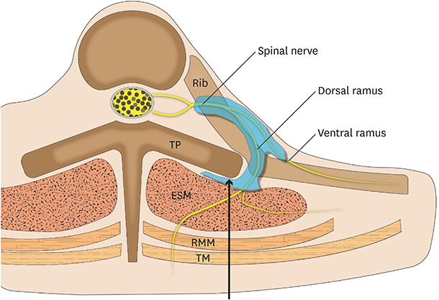
Purpose
Background
  Thoracotomy is one of the most painful surgical procedures, and inadequate pain control can increase pulmonary complications and delay recovery.
  Thoracic epidural analgesia (TEA) is the current gold standard but is associated with hypotension, contraindications, and technical failure. Erector spinae plane block (ESPB) is a newer interfascial plane block that is technically simpler and has a better safety profile.
  However, robust evidence for ESPB in thoracotomy, especially in a non-inferiority framework against TEA, is lacking.
Objectives
  To determine whether continuous ESPB provides non-inferior analgesia compared with TEA after thoracotomy in a randomized controlled, assessor-blinded, non-inferiority trial
Thoracic Epidural
Analgesia
Erector Spinae
Plane Block

Slide 3
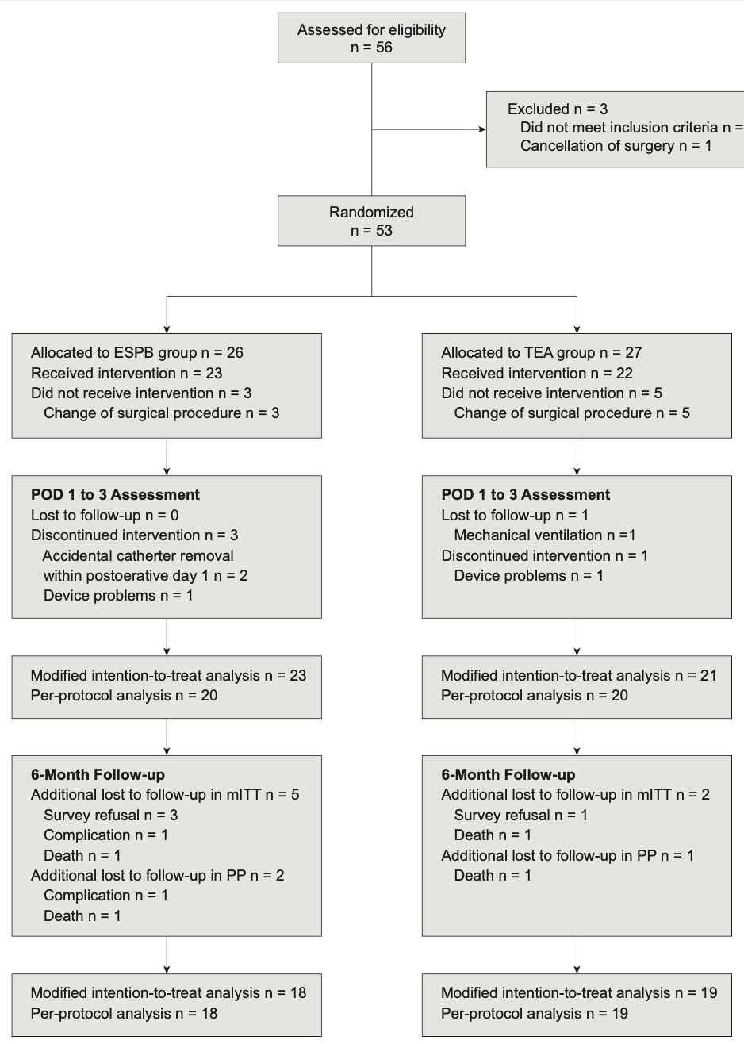
Methods
Design: Single-center, prospective, randomized, assessor-blinded, non-inferiority trial (ClinicalTrials.gov NCT05008614).
Participants: 53 adult patients undergoing elective thoracotomy; randomized 1:1 to ESPB (n=26) or TEA (n=27).
Intervention
  TEA group: Epidural catheter placed at T6–7 under fluoroscopy, continuous ropivacaine infusion with PCEA until POD3.
  ESPB group: Ultrasound-guided catheter at T5 transverse process, continuous ropivacaine infusion with PCA until POD3.
Perioperative management: All patients received standardized multimodal analgesia (acetaminophen + rescue NSAIDs/opioids as needed).
Primary endpoint: Resting NRS pain score on postoperative day (POD) 1, non-inferiority margin = 2 points.
Secondary endpoints: Pain scores POD2–3, opioid consumption, QoR-15K on POD3, chronic pain at 3/6 months, recovery parameters, and adverse events.

Slide 4
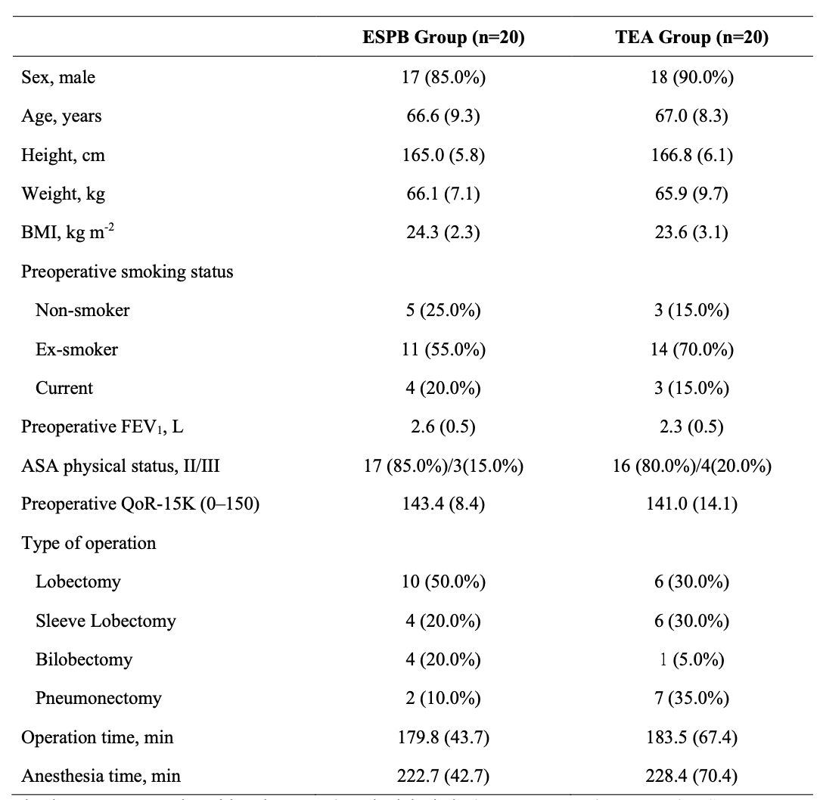
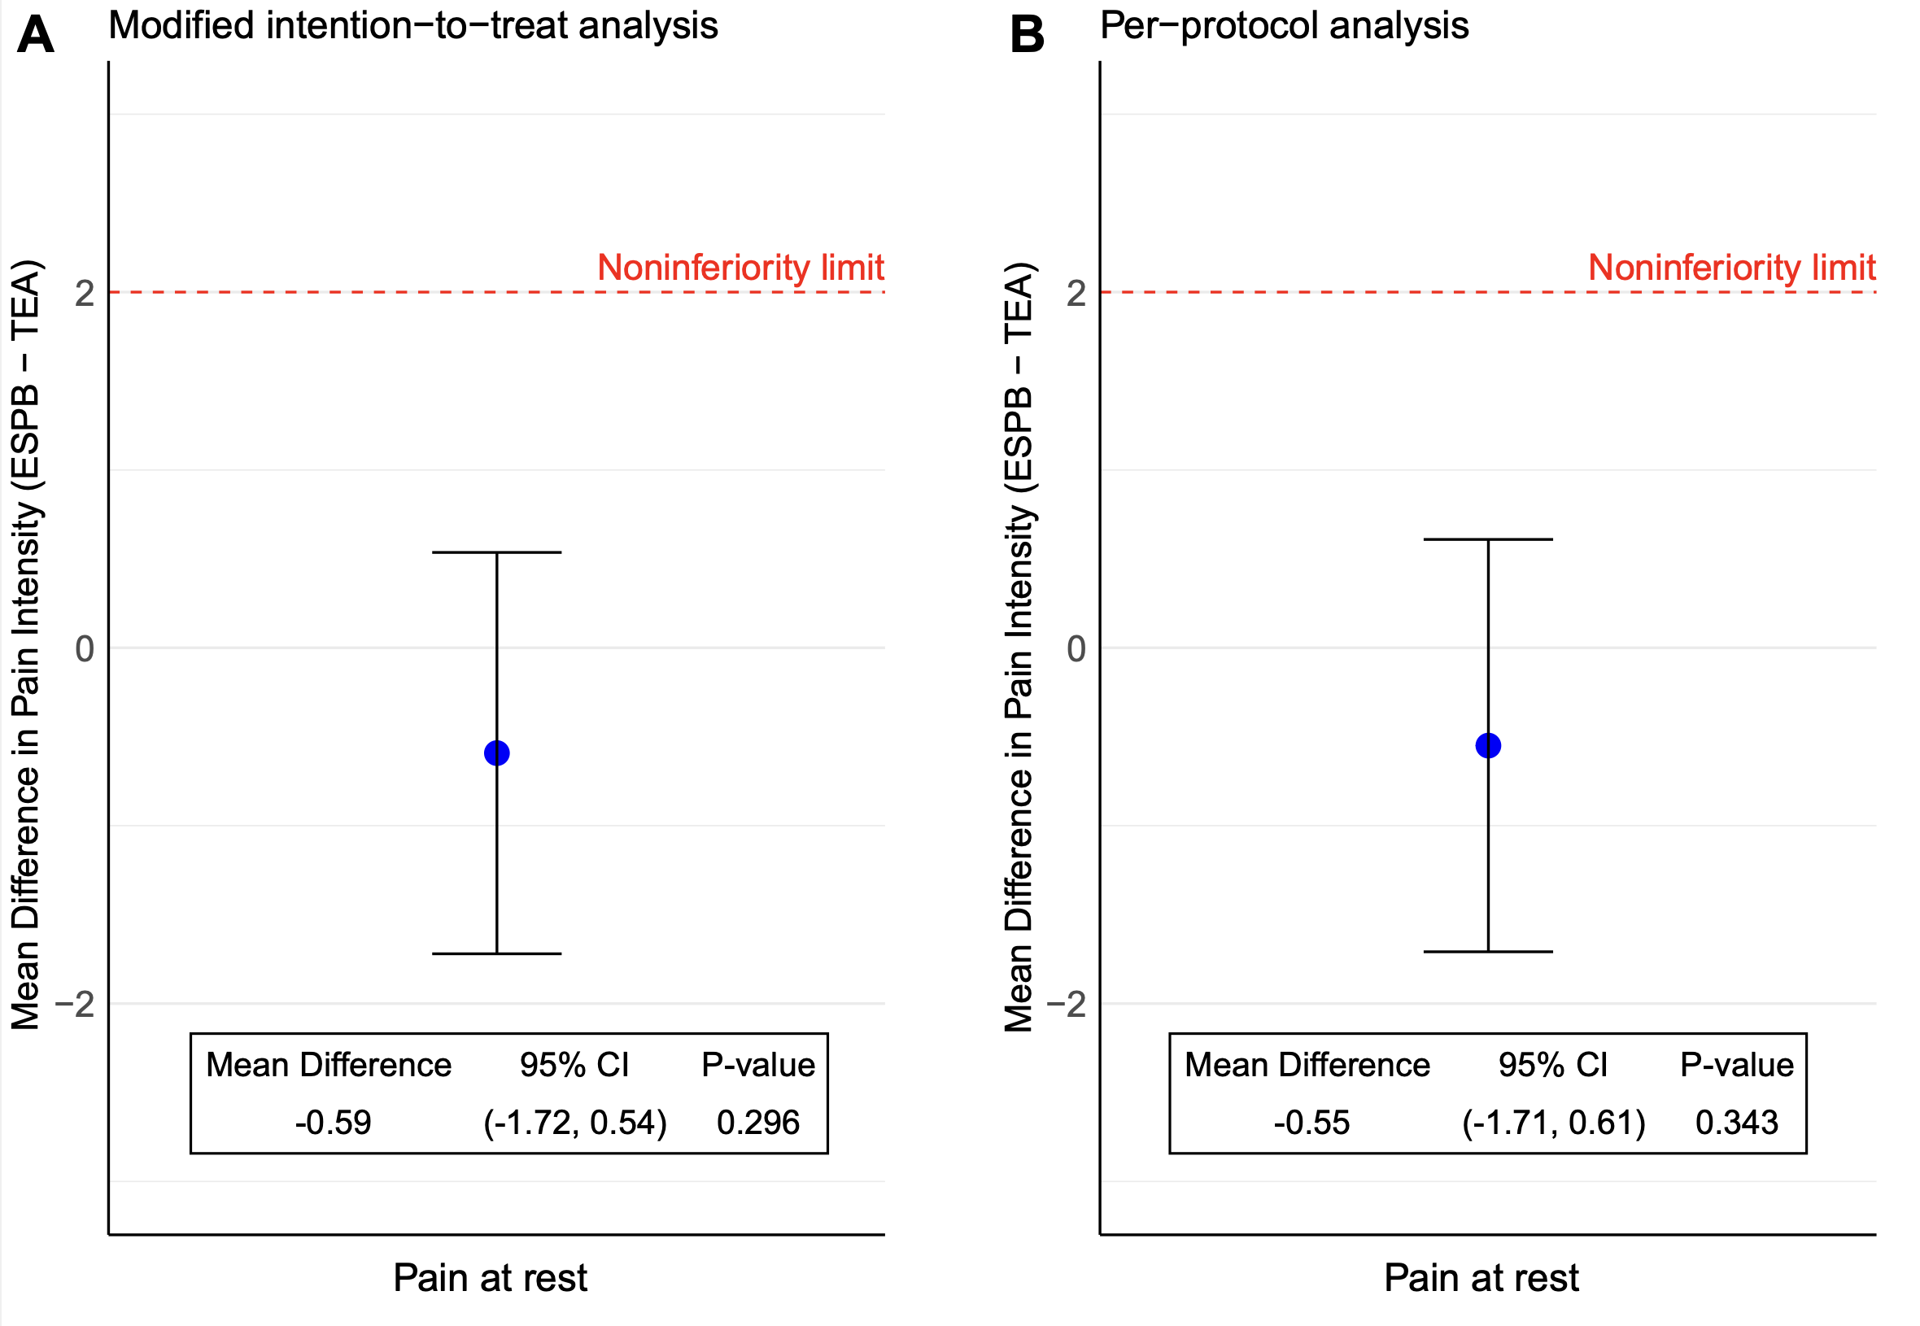
Results
Baseline characteristics
Primary endpoint:
  ESPB was non-inferior to TEA for POD1 resting pain (mean difference –0.59, CI within margin).

Slide 5
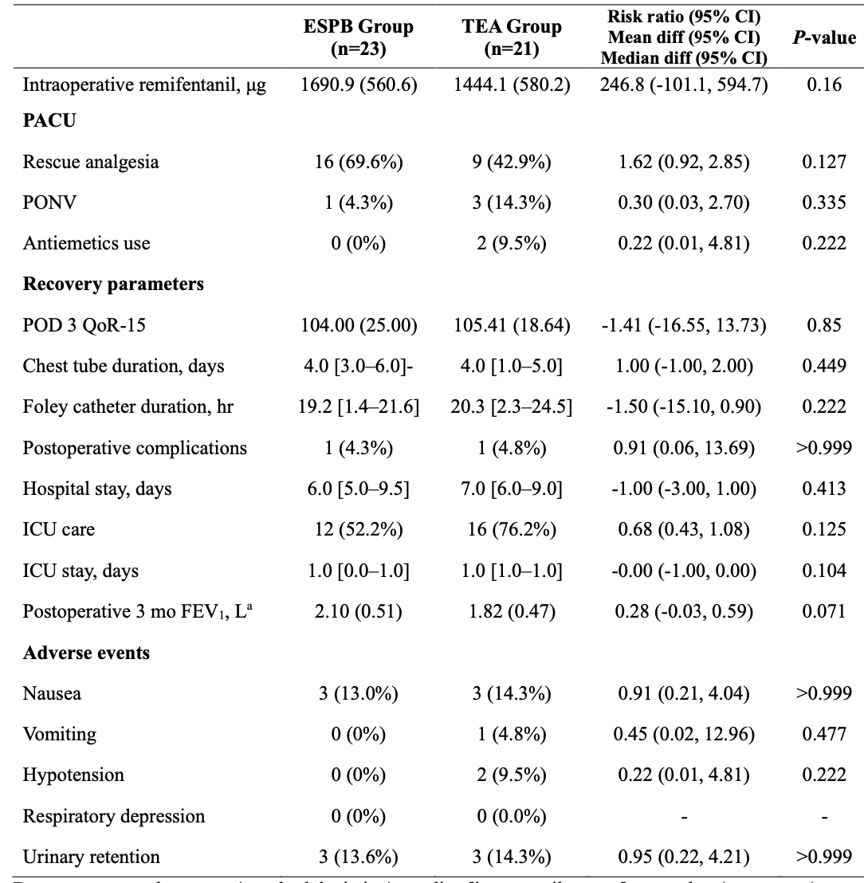
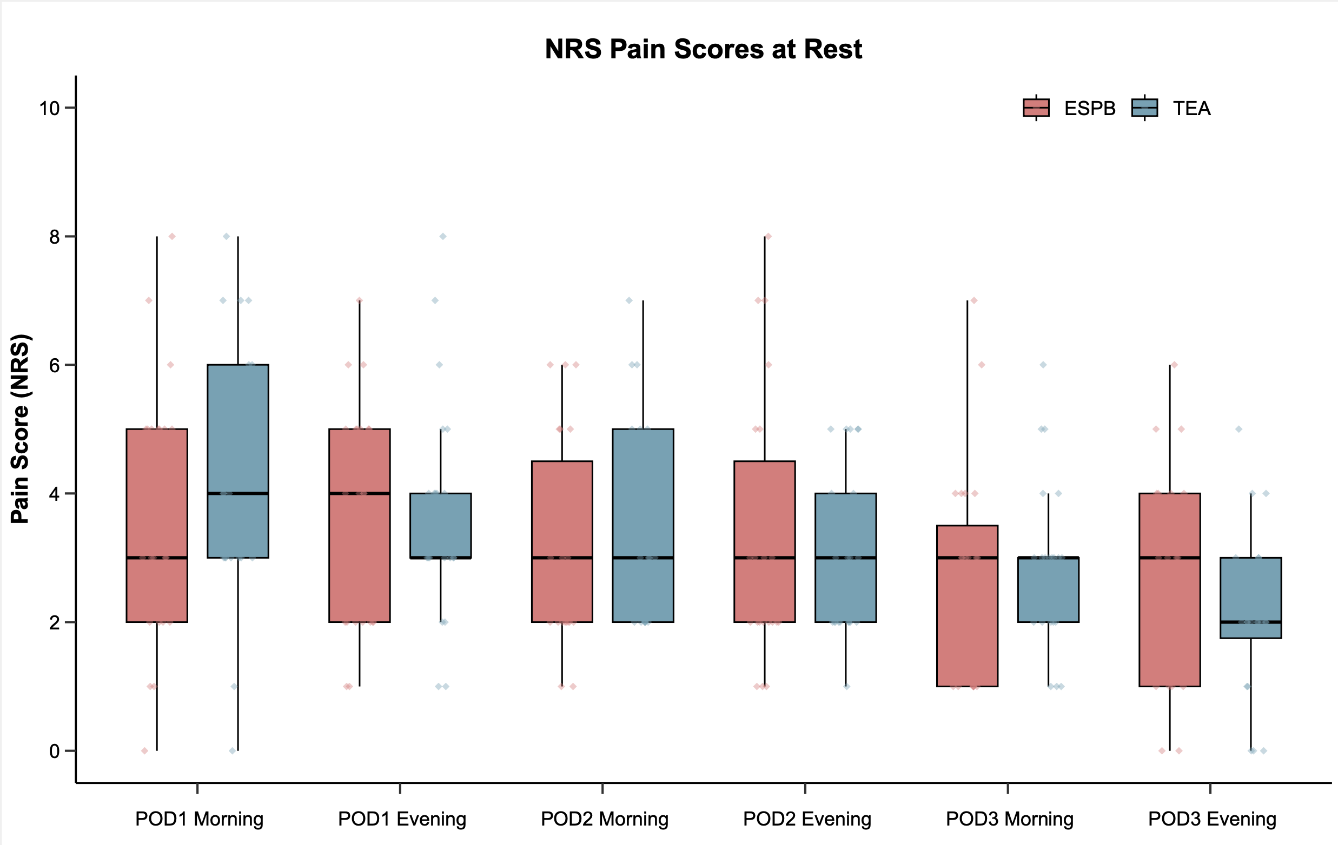
Results
Secondary endpoint:
  Pain scores on POD2–3 decreased similarly in both groups.
  Opioid consumption and QoR-15K recovery scores were comparable.
  Chronic pain at 3 and 6 months showed no group difference.
Postoperative secondary outcomes & recovery parameters

Slide 6
Conclusion
Continuous ESPB was non-inferior to TEA for postoperative pain after thoracotomy (mean NRS difference POD1: –0.59, 95% CI –1.72 to 0.54).
Secondary outcomes including pain reduction, opioid use, quality of recovery, and chronic pain were also comparable.
No major complications occurred, and hypotension was less frequent with ESPB.
ESPB offers equivalent analgesic efficacy with superior safety and technical simplicity, supporting its role as a practical alternative to TEA in thoracic surgery.

