Slide 1
Comparison of TKI monotherapy
versus TKI Combined with Surgery or Radiotherapy
in EGFR-Mutant metastatic Non-Small Cell Lung Cancer
공지사항
  소속기관이나 저자명이 드러나지 않도록 해주세요.
  제목 슬라이드 포함 최대 6장, Font size 20 이상
  PPT 파일 작성 후 PDF로 전환해서 접수(필수)

Slide 2
Purpose
EGFR-TKIs have significantly improved outcomes in metastatic EGFR-mutant NSCLC, yet most patients eventually develop disease progression.
The role of local consolidative therapy (surgery or radiotherapy) in prolonging survival beyond TKI treatment remains to be fully established.
This study evaluated the clinical impact of adding local consolidative treatments – surgery or radiotherapy – to TKI therapy in patients with EGFR-mutant metastatic NSCLC.

Slide 3
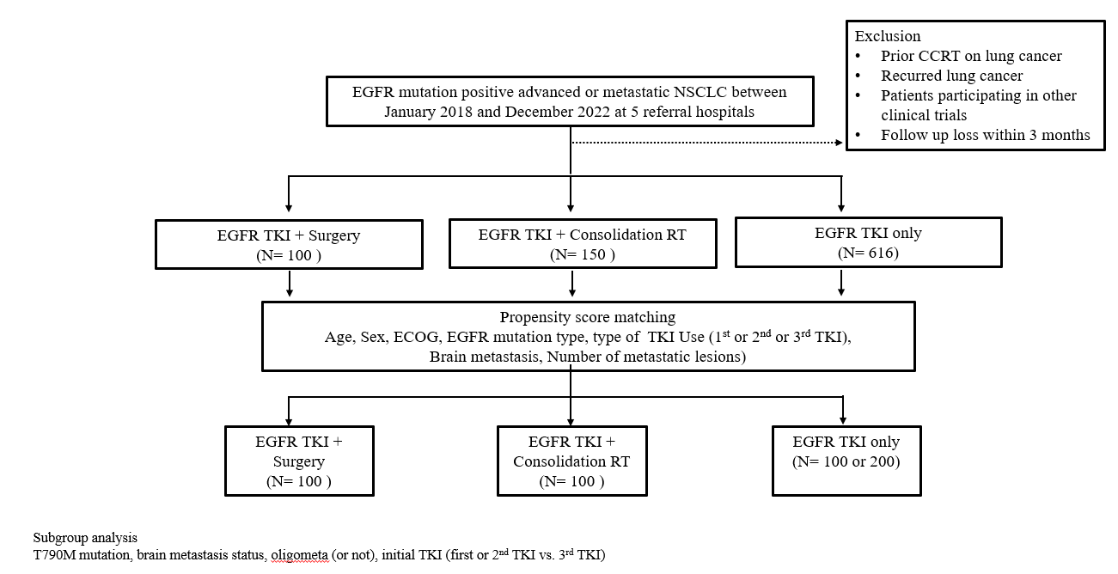
Methods
Multicenter retrospective study (5 institutions)
From 2018 to 2022
1:1 Propensity Score Matching
  Age, sex, ECOG performance status
  EGFR mutation type
  TKI generation
  Brain metastasis
  Number of metastatic sites
Total cohort
  TKI + surgery: 100
  TKI + radiotherapy: 148
  TKI only: 616
After PSM
  TKI + surgery: 97
  TKI + radiotherapy: 148
  TKI only: 97 or 148
N=97 or 148
N=97
N=148

Slide 4
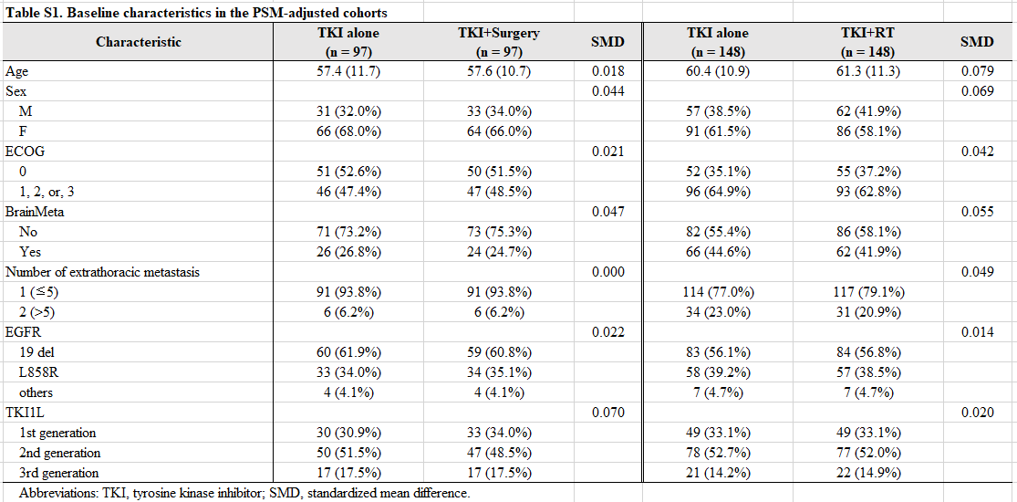
Results

Slide 5
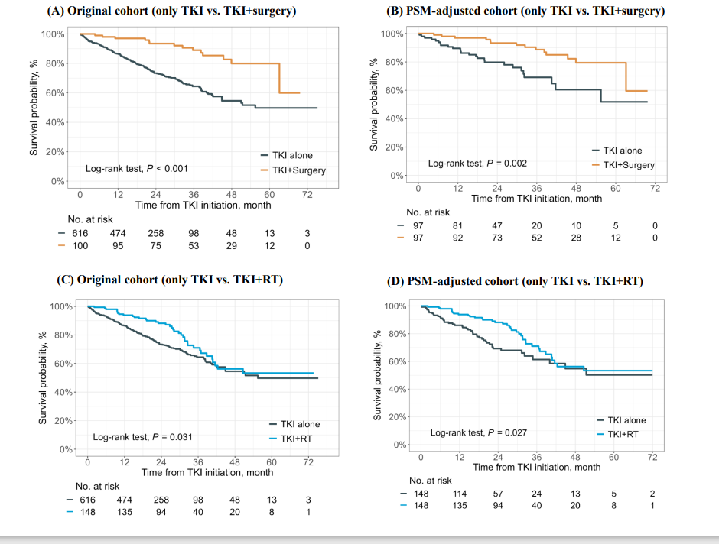
Results

Slide 6
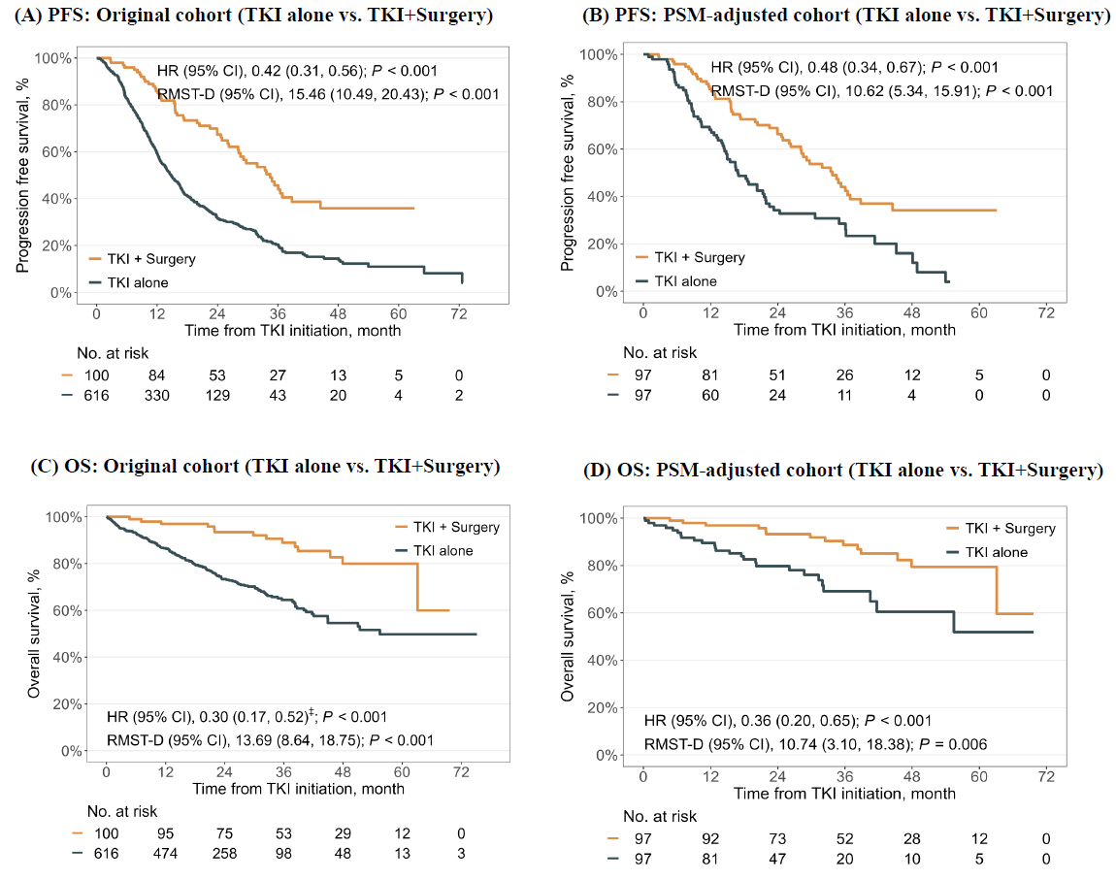
Results

Slide 7
Conclusion
In patients with EGFR-mutant metastatic NSCLC, the addition of consolidative surgery or radiotherapy to TKI therapy was associated with improved overall survival.
This benefit remained consistent after propensity score matching.
These findings highlight the importance of a multidisciplinary approach to identify candidates for consolidative treatment.

